Slide 1
Data Analytics & Visualization
T.E. AI and DS - Jan 2023
Dr. M. Vijayalakshmi

Slide 2
Module 2- Regression Models
Introduction to simple Linear Regression: The Regression Equation, Fitted value and Residuals, Least Square
Introduction to Multiple Linear Regression: Assessing the Model, Cross-Validation, Model Selection and Stepwise Regression
Prediction Using Regression

Slide 3
Introduction
Predictive analytics is one of the most common outcomes in data analytics
By identifying trends and patterns, predictive analytics helps forecast future events and can even fill in the gaps in datasets
One very popular statistical techniques used in predictive analytics is linear regression.

Slide 4
Introduction to Regression
A linear regression model allows us to see how one thing changes based on how other things change. It uses one or more independent input variables to predict a single, dependent output variable.
When there is only one input variable we call this simple linear regression.
If there are two or more inputs, this is multiple linear regression.

Slide 5
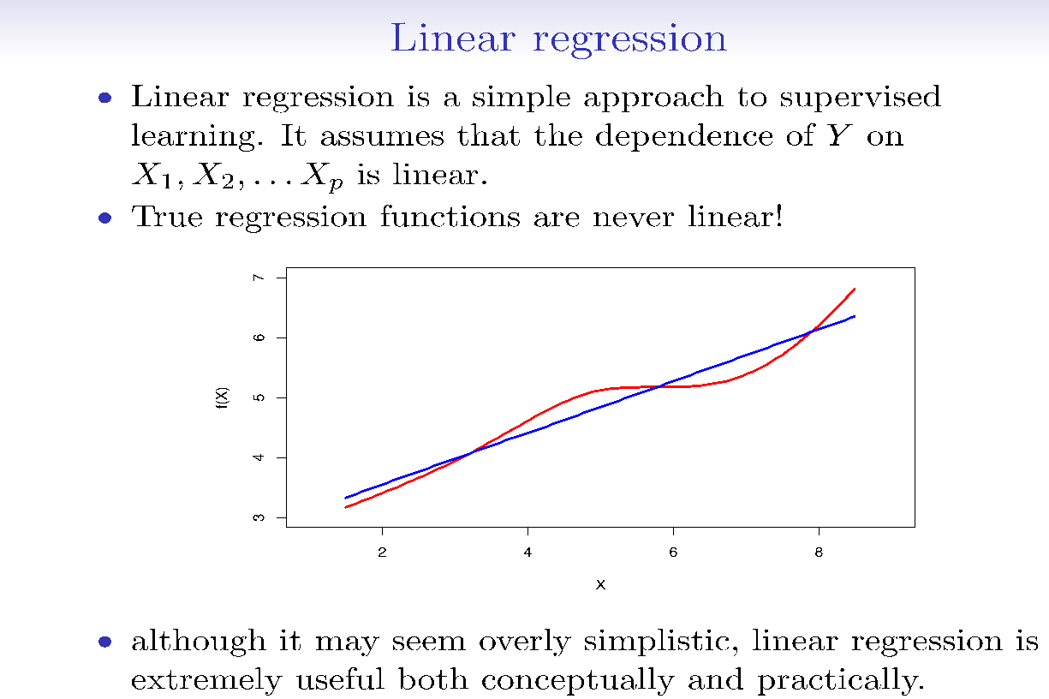

Slide 6
Introduction to Regression Analysis
Regression analysis is used to:
Predict the value of a dependent variable based on the value of at least one independent variable
Explain the impact of changes in an independent variable on the dependent variable
Dependent variable: the variable we wish to
predict or explain
Independent variable: the variable used to predict or explain the dependent variable

Slide 7
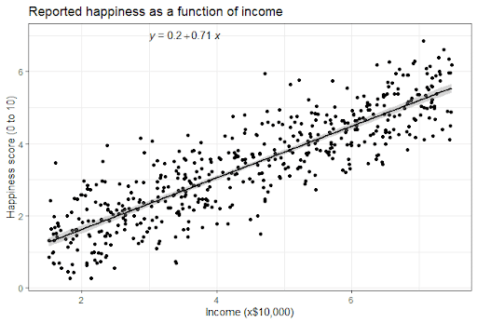
Simple Linear Regression Model
Only one independent variable, X
Relationship between X and Y is described by a linear function
Changes in Y are assumed to be related to changes in X

Slide 8
Example -Predict selling prices of houses in the region.
Intuitively, we should compare the house for which we need a predicted selling price with houses that have sold recently in the same area, same size, same style etc.
Unfortunately, the list of houses meeting these criteria may be quite small, or there may not be a house of exactly the same characteristics.
Alternative approach: Consider factors for selling price of a house in this region.
Collect historical data on selling prices & chars of each house sold (size, age, style, etc.).
Idea: one sample problem
To predict the selling price of a house without any particular knowledge of the house, we use the average selling price of all of the houses in the data set.
Better idea:
One of the factors could be size of the house
A preliminary model might posit that the average value per square foot of a new house is $40 and that the average lot sells for $20,000. So predict selling price of a house of size X (in square feet) would be: 20,000 + 40X.
house of 2,000 square feet - estimated to sell for 20,000 + 40(2,000) = $100,000.

Slide 9
Regression Model
The variable we are trying to predict (Y) is called the dependent (or response) variable.
The variable x is called the independent (or predictor, or explanatory) variable.
Our model assumes that
E(Y | X = x) = β0 + β1x (the “population line”) (1)
The interpretation is as follows:
When X (house size) is fixed at a level x, then we assume the mean of Y (selling price) to be linear around the level x, where β0 is the (unknown) intercept and β1 is the (unknown) slope or incremental change in Y per unit change in X.
β0 and β1 are not known exactly, but are estimated from sample data. Their estimates are denoted b0 and b1.

Slide 10
Simple Linear Regression
The relationship shown by a Simple Linear Regression model is linear or a sloped straight line, hence it is called Simple Linear Regression.
Simple Linear regression algorithm has mainly two objectives:
Model the relationship between the two variables. Such as the relationship between Income and expenditure, experience and Salary, etc.
Forecasting new observations. Such as Weather forecasting according to temperature, Revenue of a company according to the investments in a year, etc.

Slide 11
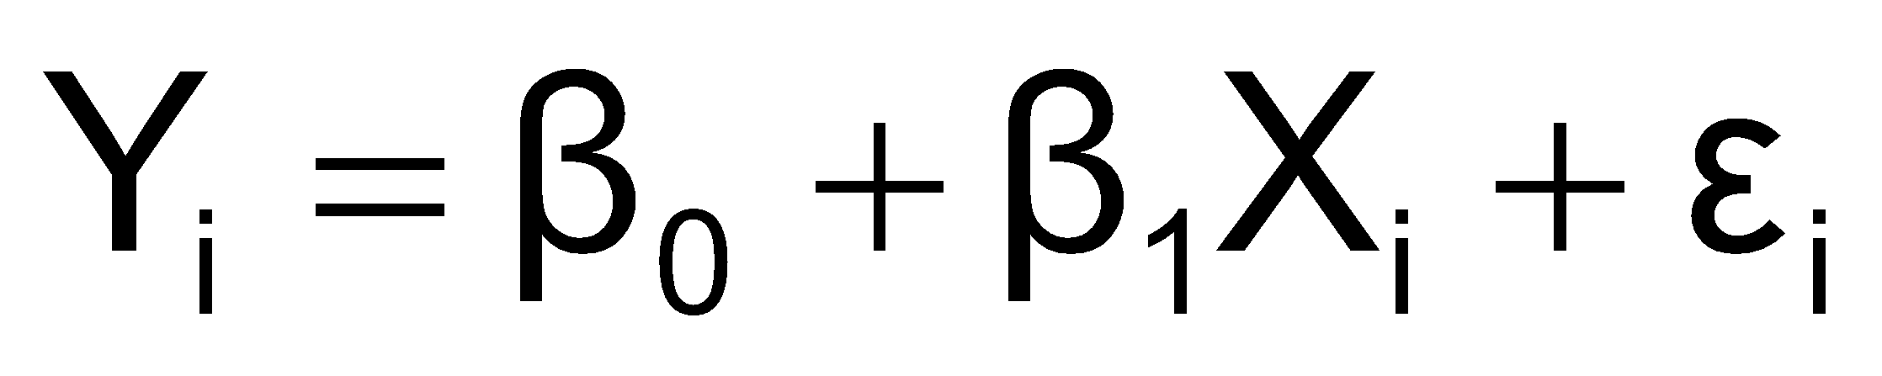
Simple Linear Regression Model
Population Slope Coefficient
Random Error term
Population Y intercept
Independent Variable
Dependent Variable
Linear component
Random Error
component

Slide 12
Simple Linear Regression Model
Y
Observed Value of Y for X_{i}
ε_{i}
Slope = β₁
Predicted Value of Y for X_{i}
Random Error for this X_{i} value
Intercept = β₀
X_{i}
X

Slide 13
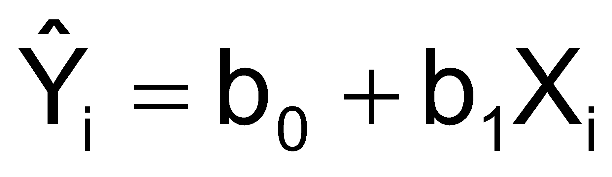
Simple Linear Regression Equation (Prediction Line)
The simple linear regression equation provides an estimate of the population regression line
Estimated (or predicted) Y value for observation i
Estimate of the regression intercept
Estimate of the regression slope
Value of X for observation i

Slide 14
House Number | Y: Actual Selling Price ($1,000s) | X: House Size (100s ft2)
1 | 89.5 | 20.0
2 | 79.9 | 14.8
3 | 83.1 | 20.5
4 | 56.9 | 12.5
5 | 66.6 | 18.0
6 | 82.5 | 14.3
7 | 126.3 | 27.5
8 | 79.3 | 16.5
9 | 119.9 | 24.3
10 | 87.6 | 20.2
11 | 112.6 | 22.0
12 | 120.8 | .019
13 | 78.5 | 12.3
14 | 74.3 | 14.0
15 | 74.8 | 16.7
Averages | 88.84 | 18.17
Sample 15 houses from the region.

Slide 15
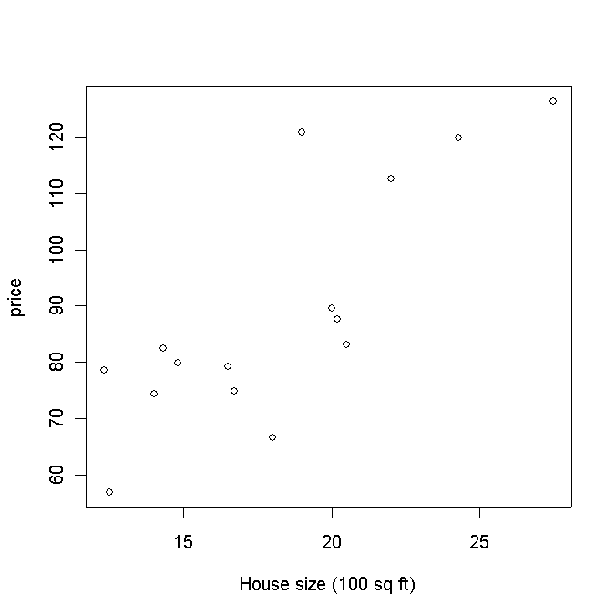
These data do not form a perfect line.
In other words, if we assume equation (1) then our line predicts the mean for any given level x.
However, when we actually take a measurement (i.e., observe the data), we observe:
Y_{i} = β₀ + β₁X_{i} + ε_{i}, for i = 1,2,…, n = 15,
where ε_{i} is the random error associated with the ith observation.
Since we don't know the true values of β₀ and β₁, it is clear that we do not observe the actual errors (ε_{i})

Slide 16
Regression
The regression equation models the relationship between a response variable Y and a predictor variable X as a line.
A regression model yields fitted values and residuals — predictions of the response and the errors of the predictions.
Regression models are typically fit by the method of least squares. Regression is used both for prediction and explanation.

Slide 17
Basic Assumptions of the Simple Linear Regression Model
The distribution of ε at any particular x value has mean value 0.
The standard deviation of ε is the same for any particular value of x. This standard deviation is denoted by s.
The distribution of ε at any particular x value is normal.
The random errors are independent of one another.

Slide 18
Interpretation of Terms
The line α + βx describes average value of y for any fixed value of x.
The slope β of the population regression line is the average change in y associated with a 1-unit increase in x.
The intercept α is the height of the population line when x = 0.
The size of σ determines the extent to which (x, y) observations deviate from the population line.
Small σ
Large σ

Slide 19
Data
Usually 3 population parameters, α, β and σ, are unknown.
We need to estimate them from data.
Data: n pairs of observations of independent and dependent variables
(x1,y1), (x2,y2), …, (xn,yn)
Probabilistic model
yi = a + b xi + ei, i=1,…,n
ei are independent normal with mean 0 & standard deviation s.

Slide 20
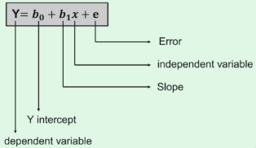
Linear Regression
The main goal of linear regression is to consider the given data points and plot the best fit line to fit the points
The cost function provides the best possible values for b₀ and b₁ to make the best fit line for the data points.
We do it by converting this problem into a minimization problem to get the best values for b₀ and b₁.
The error is minimized in this problem between the actual value and the predicted value.

Slide 21
Steps in Regression Analysis
Fit the model to data – estimate parameters.
Use the analysis of variance F test (or t test) and r2 to determine how well the model fits the data.
Use diagnostic plots to check for violation of the regression assumptions.
Proceed to estimate or predict the quantity of interest

Slide 22
Regression Analysis
Regression models create a optimal equation for modelling the given data, by minimizing the error between the results predicted by the model and the provided data.
In reality no regression model will ever be perfect (and if perfect we should check for overfitting).
There will always be a difference between the values predicted by a regression model and the actual data.
Those differences will change dramatically as you change the structure of the model. This is residuals analysis.

Slide 23
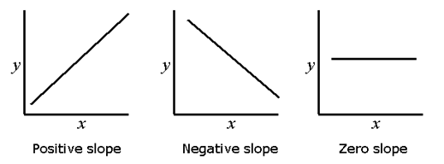
Interpreting the Regression LIne
The regression line describes the nature of the relationship between the dependent variable y and the independent variable x.
The slope of the line reflects the degree to which the variable y changes linearly as a function of changes in the variable x.
The sign of the slope indicates whether the relationship between x and y is positive or negative.
A positive slope indicates that both variables changes in the same direction; and a negative slope indicates that x and y changes in opposite directions.
If there is no linear relationship between x and y, then the regression line will be flat (zero slope).

Slide 24
Residuals
The residual for a specific data point is the difference between the value predicted by the regression (called fitted values) and the observed value for that data point.
Calculating the residual provides a valuable clue into how well your model fits the data set.
A poorly fit regression model will yield residuals for some data points that are very large, which indicates the model is not capturing a trend in the data set.
A well-fit regression model will yield small residuals for all data points.

Slide 25
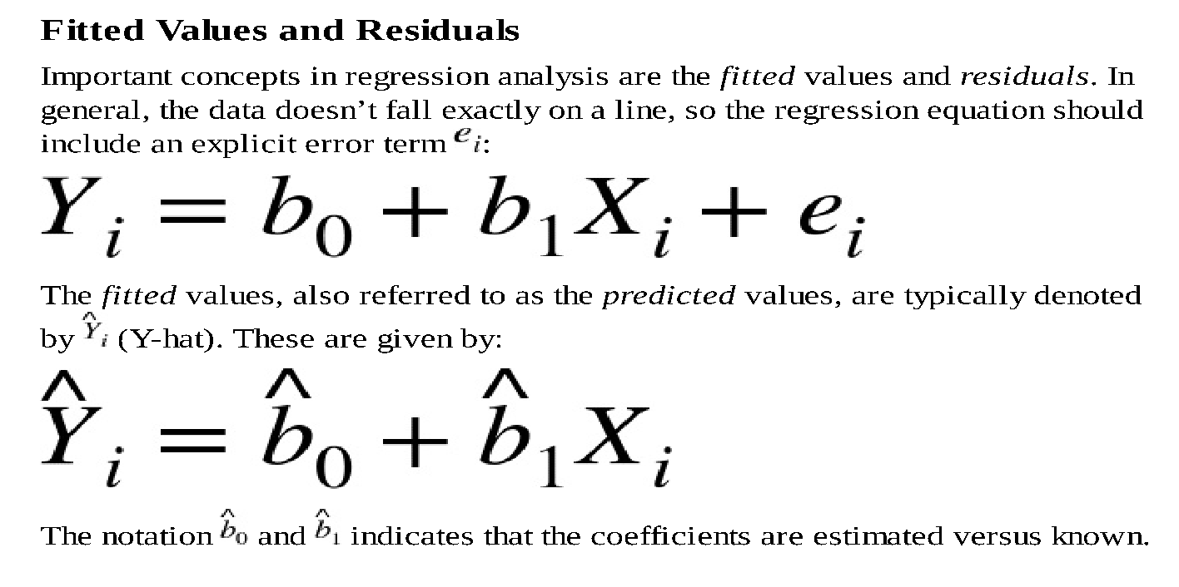
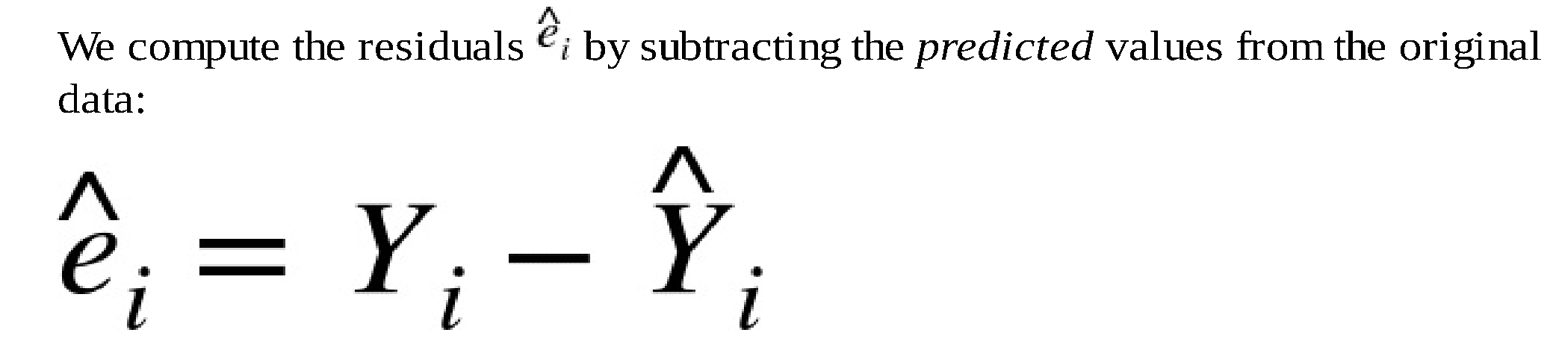

Slide 26
Fitted line plot and residuals
Since the residuals are actual number values, they can also be plotted.
The residuals plot should conform to certain assumptions and will tell you about the validity of your regression.
If you severely violate the assumptions, you need to go back and evaluate your regression model.
The assumptions are:
Residuals should be normally distributed around a mean of 0
Residuals should have a constant variance
Residuals should be uncorrelated with each other
Residuals should be independent of the order of the data

Slide 27
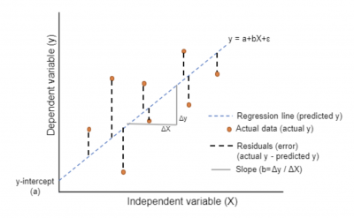
Residuals and Fitted Points
A residual is the vertical distance from the prediction line to the actual plotted data point for the paired X and Y data values.
The residual is the error associated with the prediction line.

Slide 28

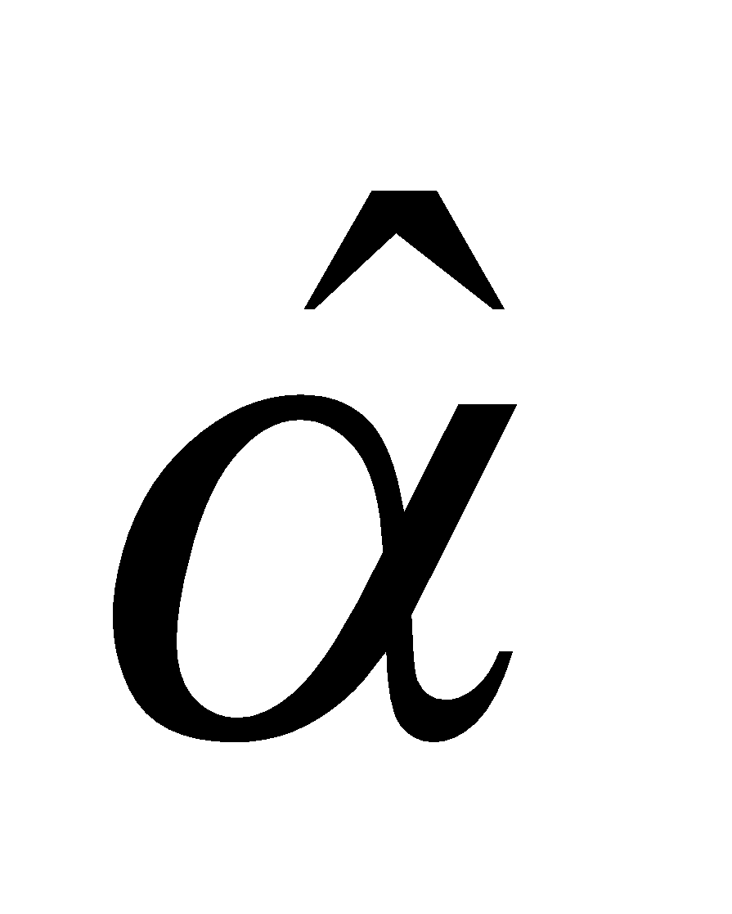

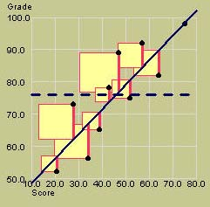
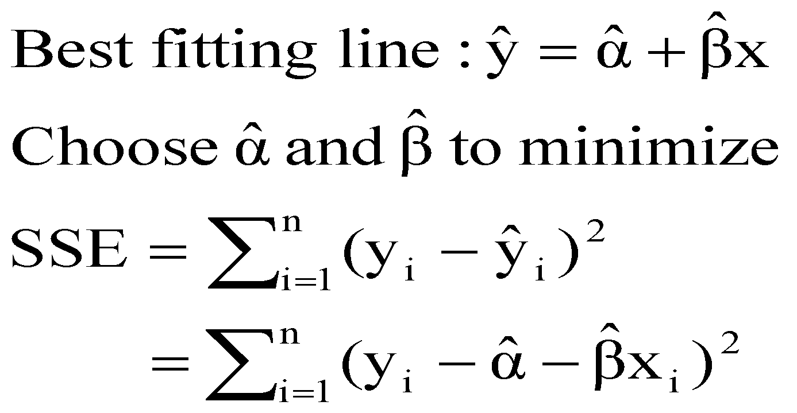
The Method of Least Squares
The equation of the best-fitting line is calculated using n pairs of data (x_{i}, y_{i}).
We choose our estimates and to estimate α and β so that the vertical distances of the points from the line,
are minimized.

Slide 29
The Least Squares Method
b₀ and b₁ are obtained by finding the values that minimize the sum of the squared differences between Y and Y :
∧

Slide 30
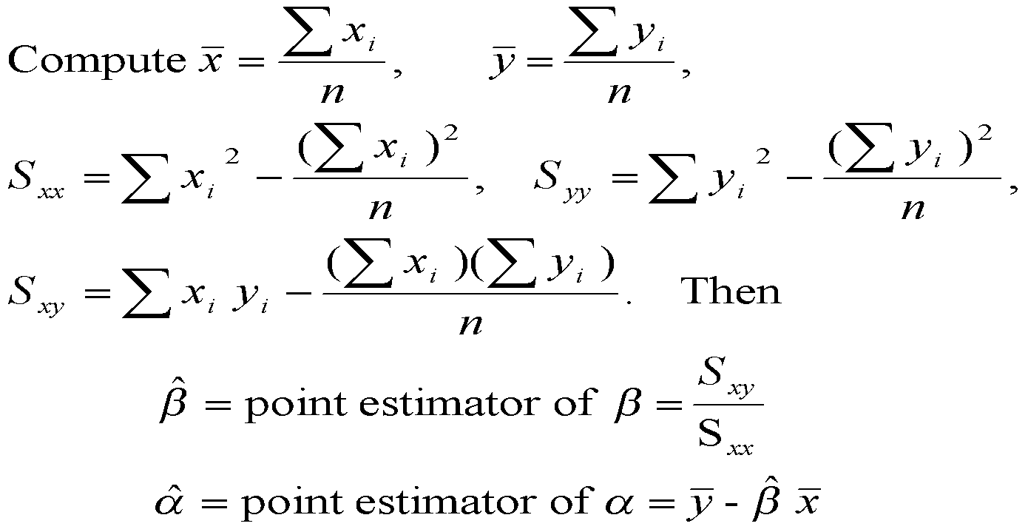
Least Squares Estimators

Slide 31
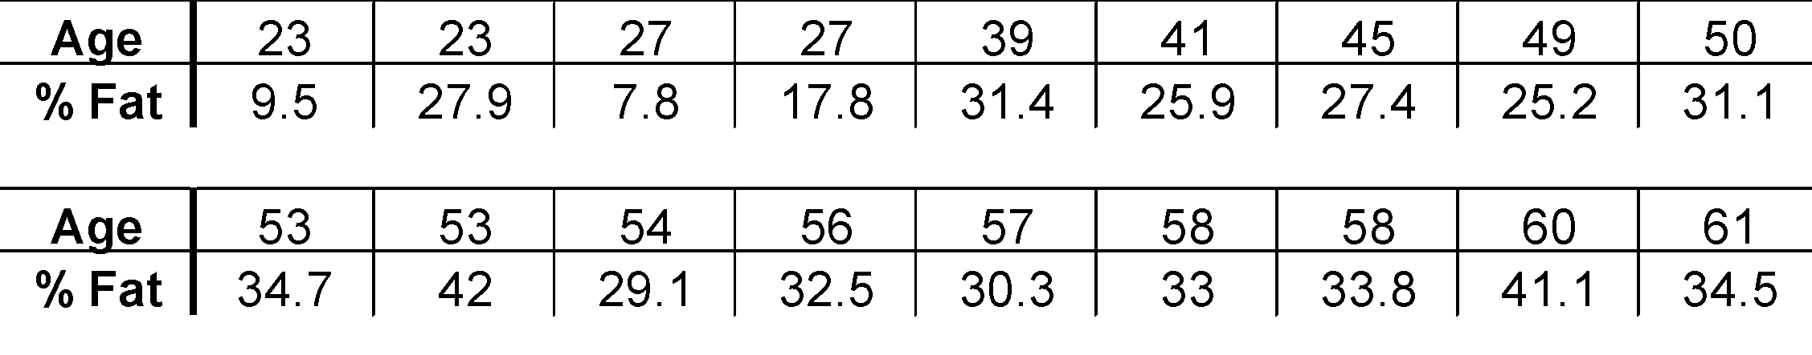
Example: Age and Fatness
The following data was collected in a study of age and fatness in humans.
One questions
“What is the relationship between age and fatness?”
* Mazess, R.B., Peppler, W.W., and Gibbons, M. (1984) Total body composition by dual-photon (¹⁵³Gd) absorptiometry. American Journal of Clinical Nutrition, 40, 834-839

Slide 32
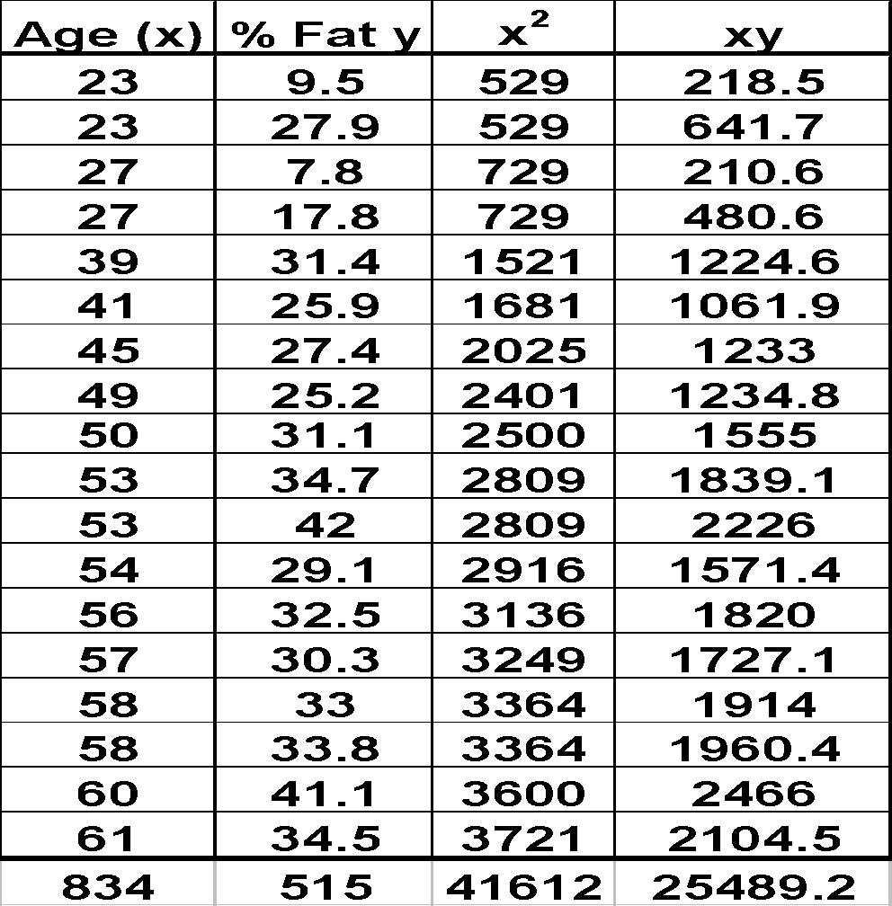
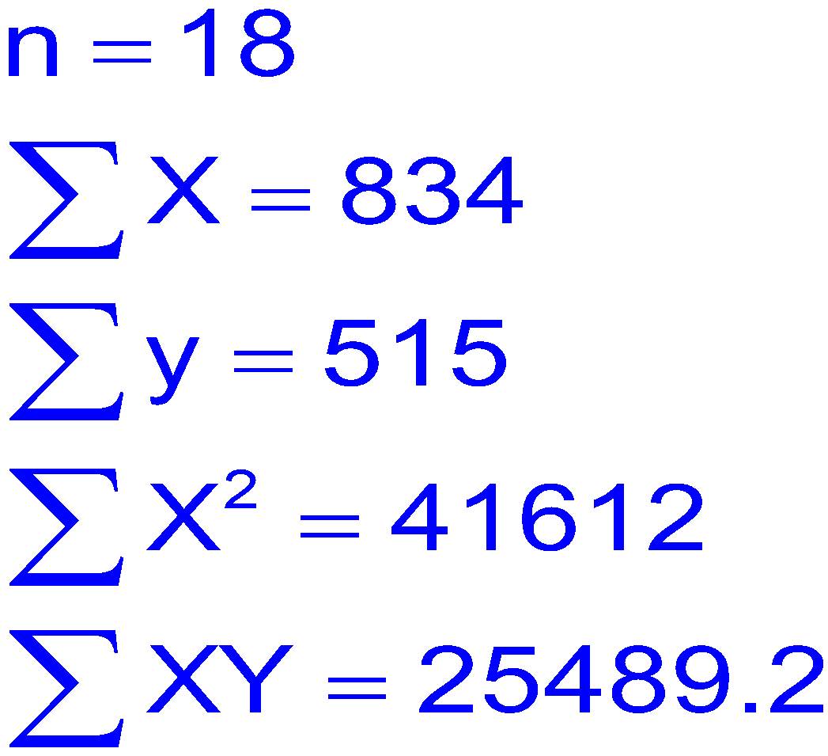
Example

Slide 33
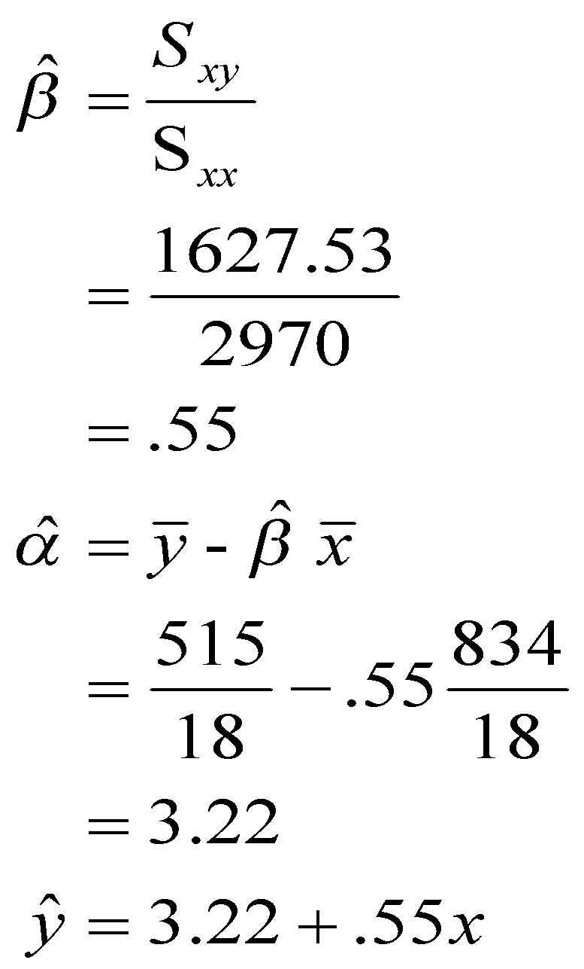
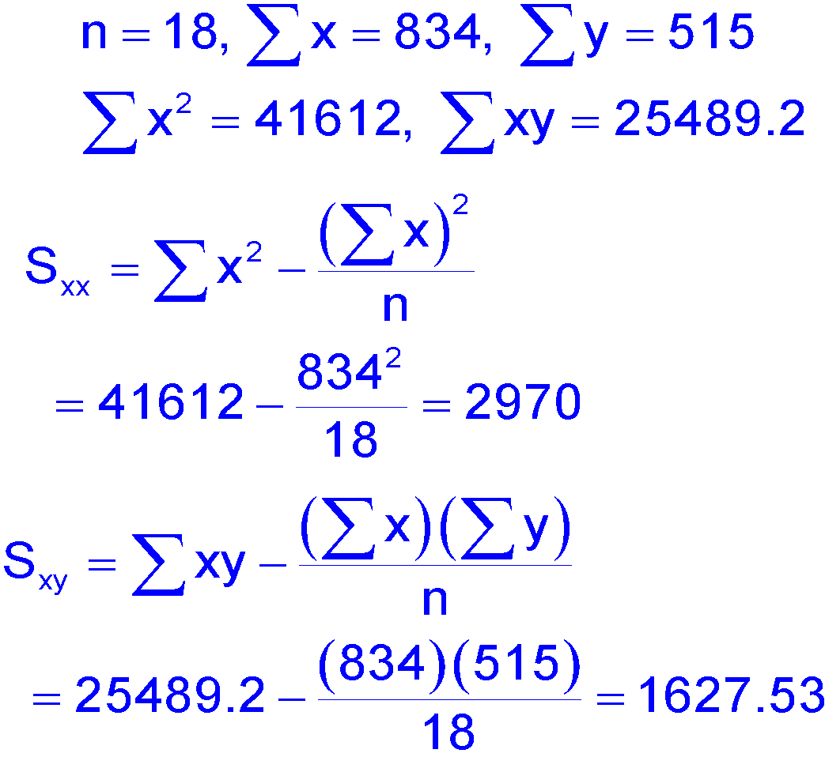
Example: Age and Fatness

Slide 34
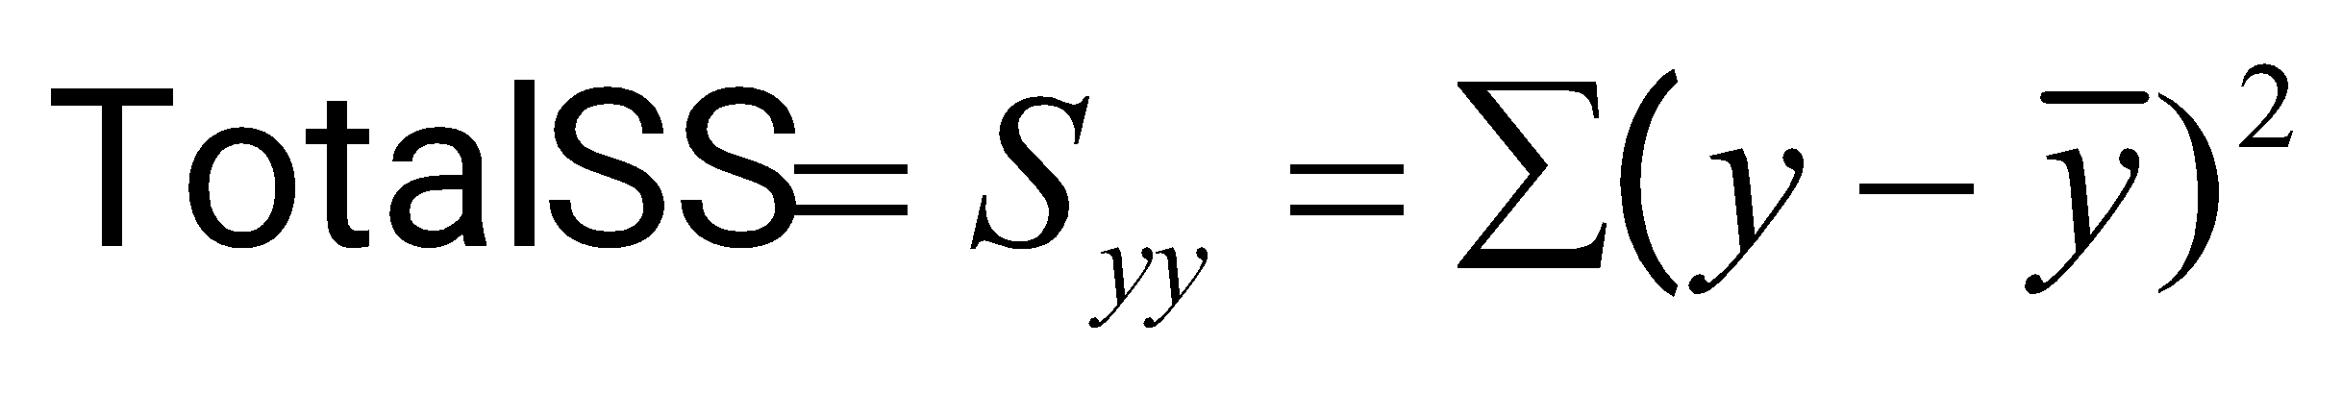
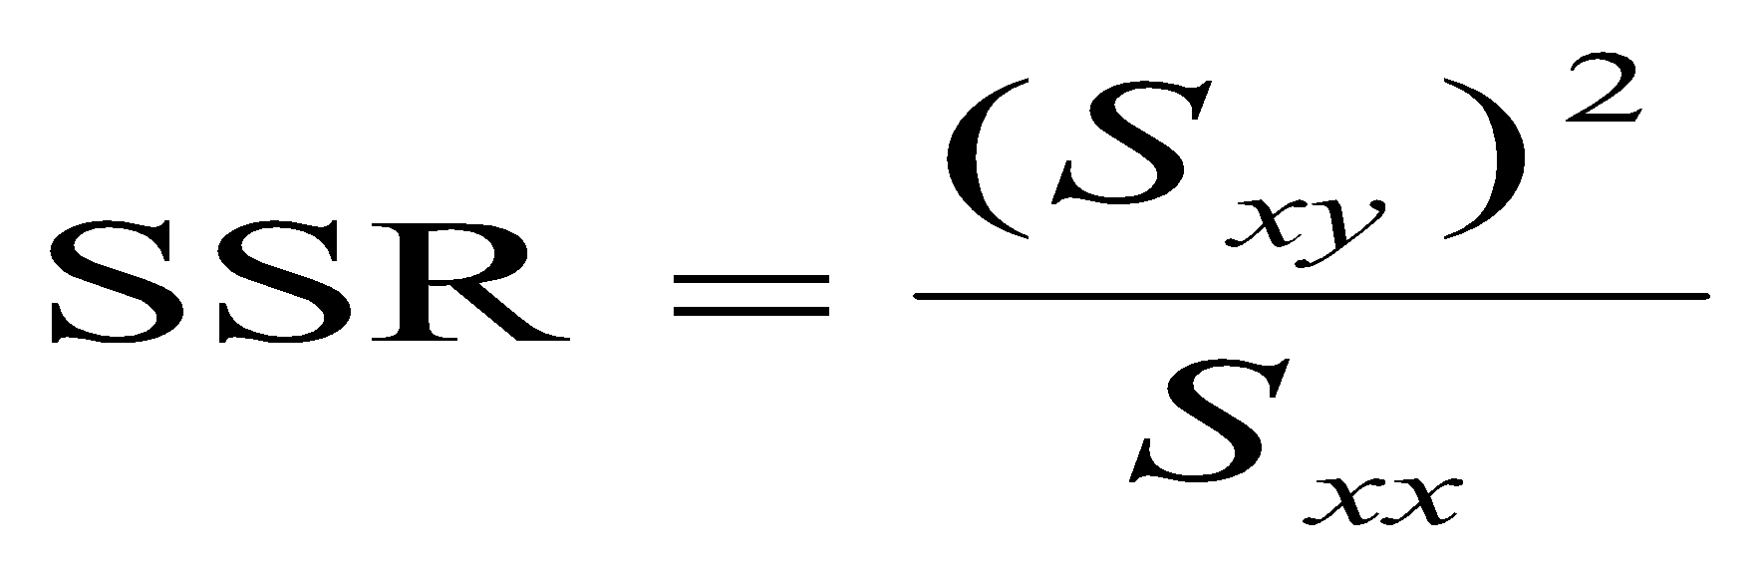
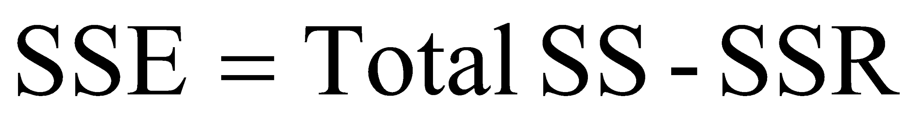
The Analysis of Variance
The total variation in the experiment is measured by the total sum of squares:
The Total SS is divided into two parts:
SSR (sum of squares for regression): measures the variation explained by including the independent variable x in the model.
SSE (sum of squares for error): measures the leftover variation not explained by x.

Slide 35
The ANOVA Table
Total df = Mean Squares
Regression df =
Error df =
n -1
MSR = SSR/1
1
n –1 – 1 = n - 2
MSE = SSE/(n-2)
Source | df | SS | MS | F
Regression | 1 | SSR | MSR | MSR/MSE
Error | n - 2 | SSE | MSE
Total | n - 1 | Total SS

Slide 36
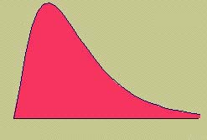
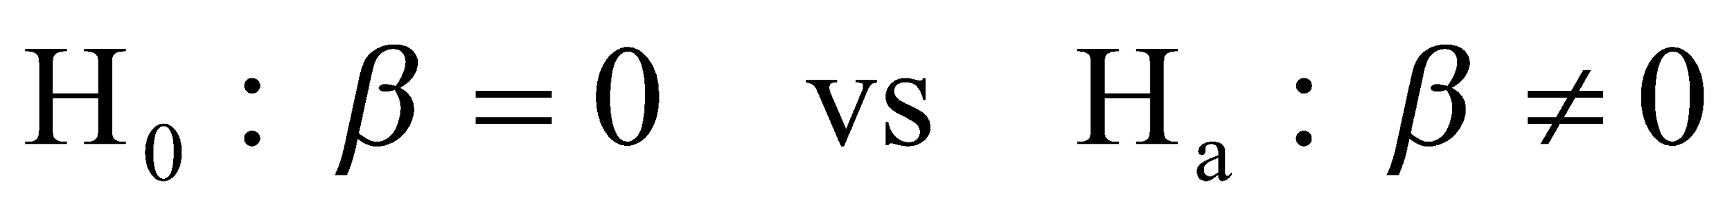
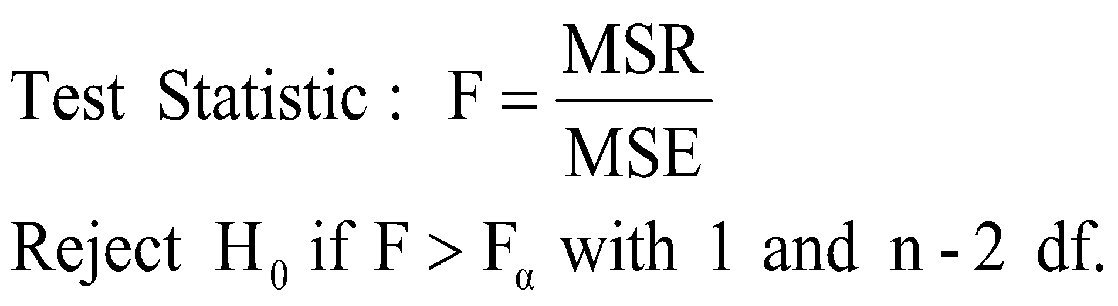
The F Test
We can test the overall usefulness of the linear model using an F test. If the model is useful, MSR will be large compared to the unexplained variation, MSE.

Slide 37
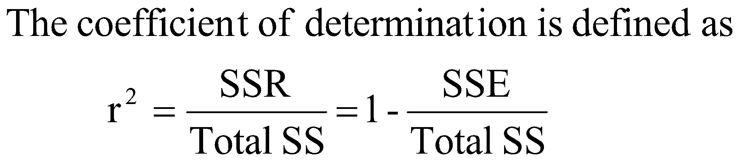
Coefficient of Determination
r² is the square of correlation coefficient
r² is a number between zero and one and a value close to zero suggests a poor model.
It gives the proportion of variation in y that can be attributed to an approximate linear relationship between x and y.
A very high value of r² can arise even though the relationship between the two variables is non-linear. The fit of a model should never simply be judged from the r² value alone.

Slide 38
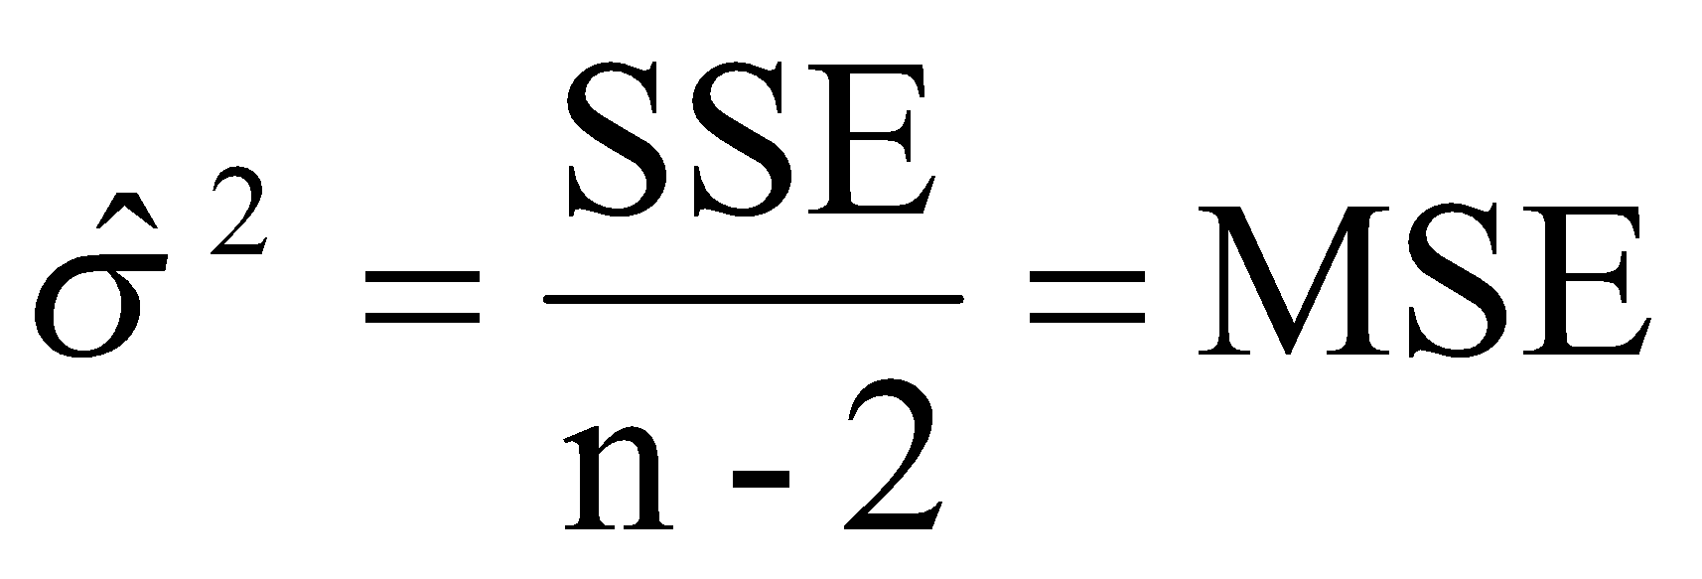
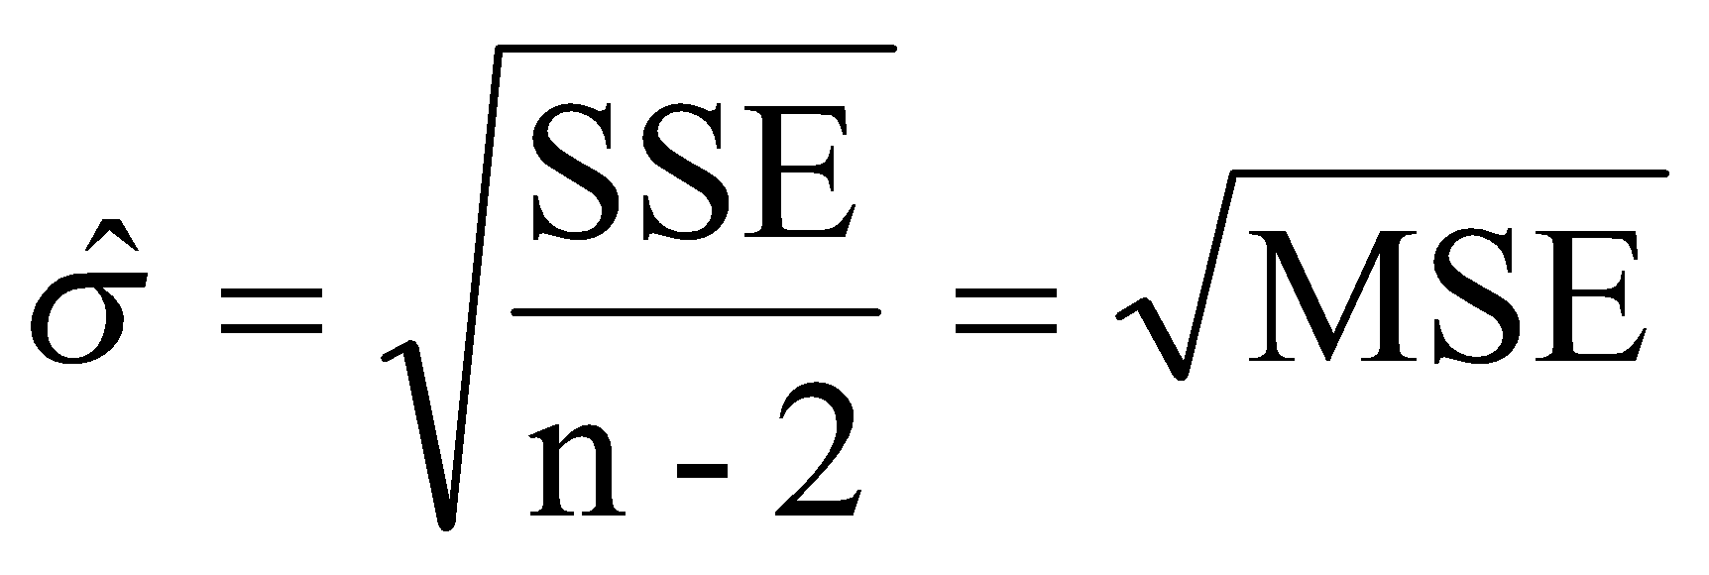
Estimate of σ
An estimator of the variance σ² is
Thus, an estimator of the standard deviation σ is

Slide 39
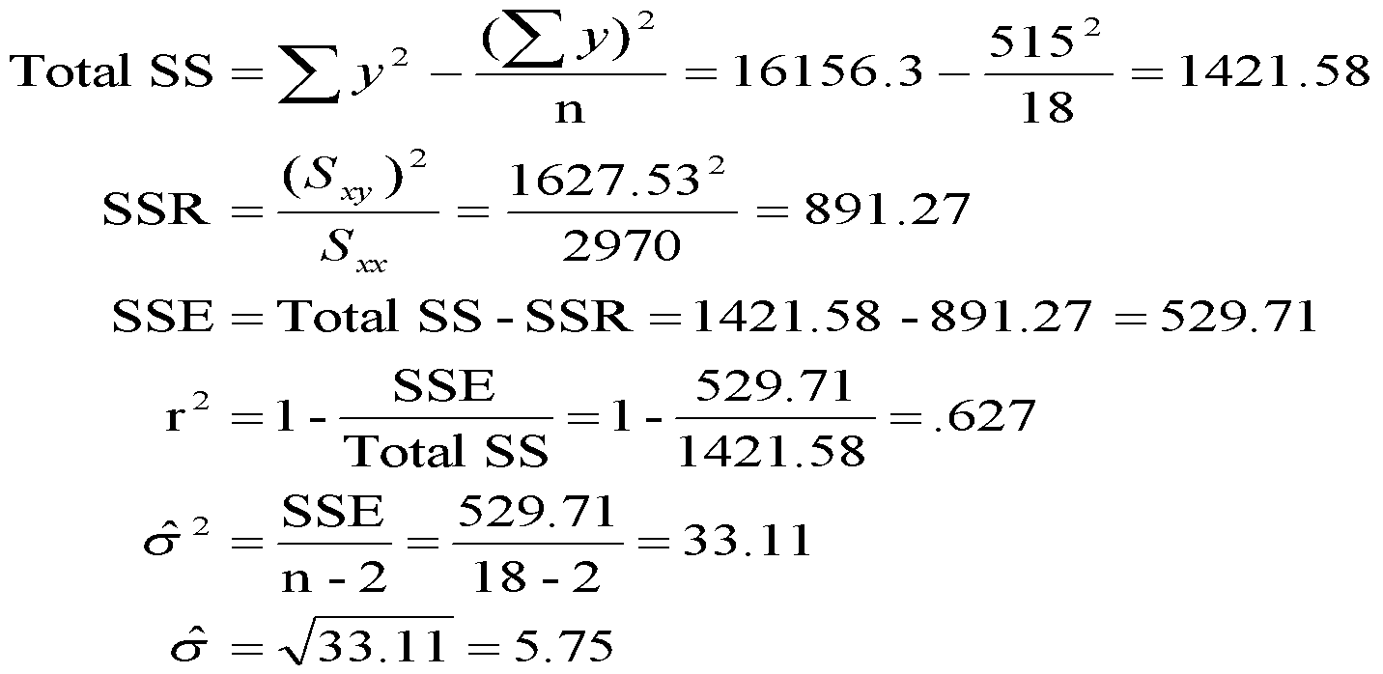
Example: Age and Fatness

Slide 40
Example: Age and Fatness
ANOVA Table
Source | df | SS | MS | F
Regression | 1 | 891.27 | 891.27 | 26.94
Error | 16 | 529.71 | 33.11
Total | 17 | 1421.58
With r²=0.627 or 62.7%, we can say that 62.7% of the observed variation in %Fat can be attributed to the probabilistic linear relationship with human age.
The magnitude of a typical sample deviation from the least squares line is about 5.75(%) which is reasonably large compared to the y values themselves.
This would suggest that the model is only useful in the sense of provide gross ballpark estimates for %Fat for humans based on age.

Slide 41
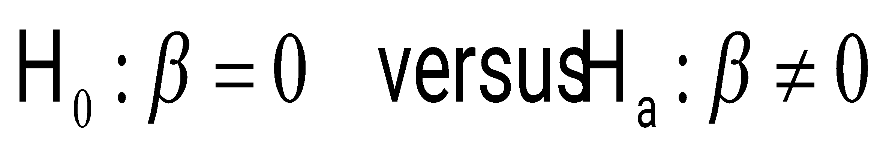
Inference Concerning the Slope β
Do the data present sufficient evidence to indicate that y increases (or decreases) linearly as x increases?
Is the independent variable x useful in predicting y?
A no answer to above questions means that y does not change, regardless of the value of x. This implies that the slope of the line, β, is zero.

Slide 42
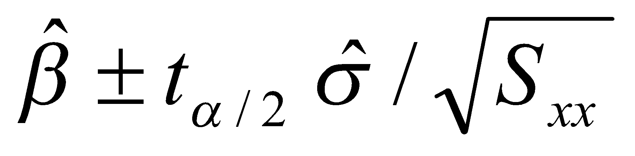
Confidence Interval for β
When then four basic assumptions of the simple linear regression model are satisfied, a (1-α)100% confidence interval for β is
where the t critical value is based on df = n - 2.

Slide 43
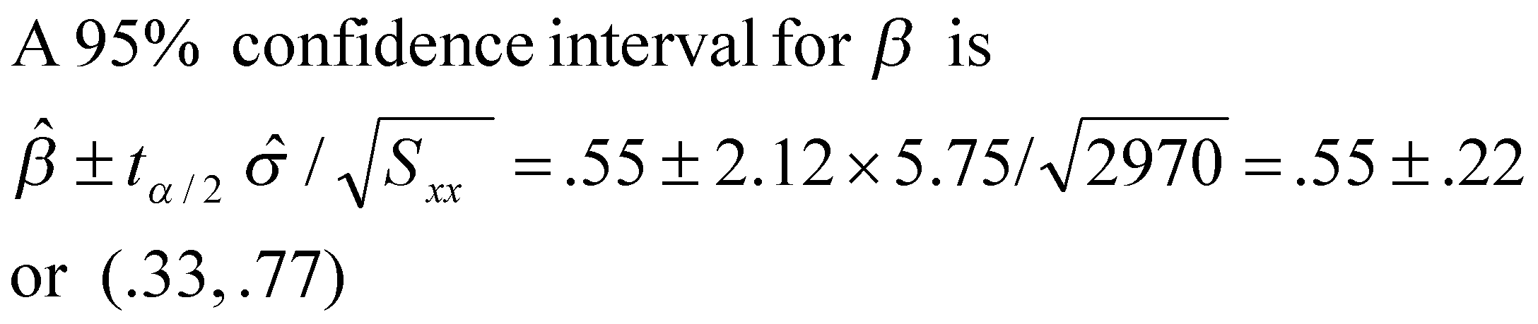
Example: Age and Fatness
Based on sample data, the %Fat increases .55% on average with one year of age, and we are 95% confident that the true increase per year is between 0.33% and 0.77%.

Slide 44
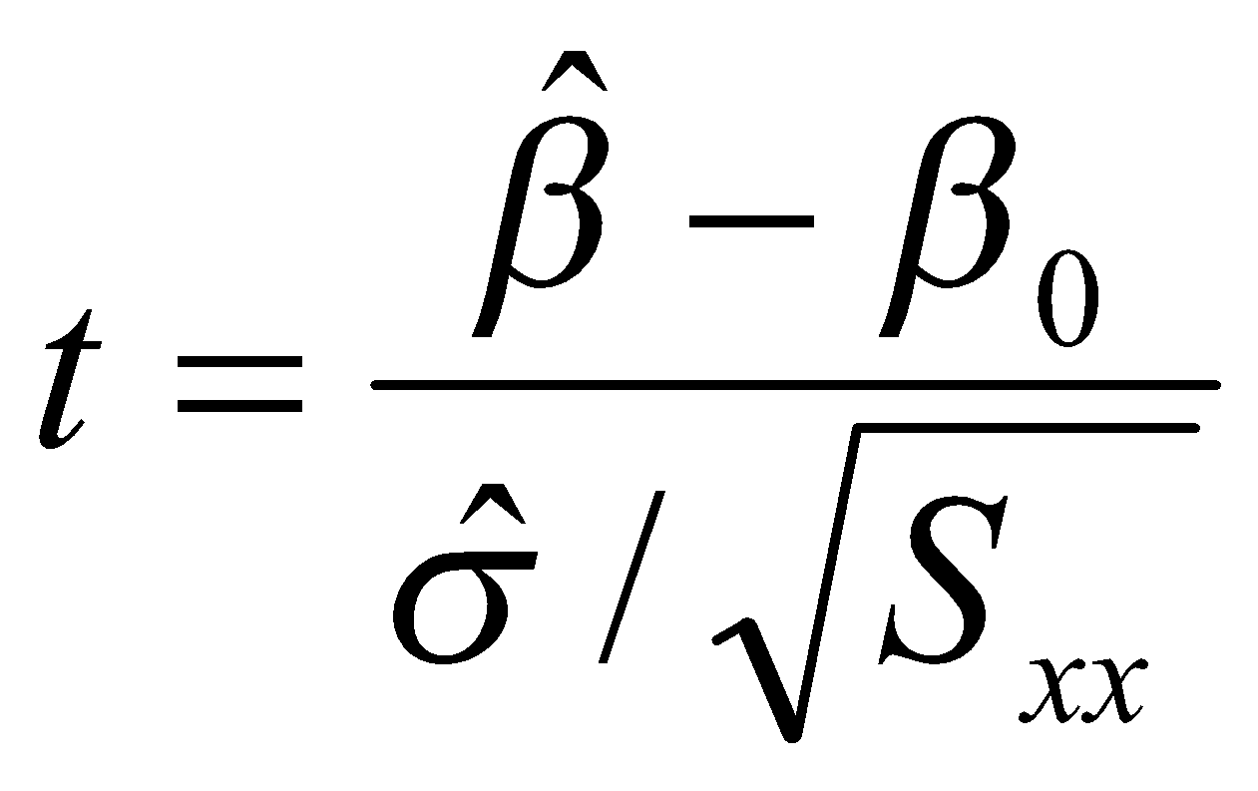
Hypothesis Tests Concerning β
Step 1: Specify the null and alternative hypothesis
H₀: β = β₀ versus H_{a}: β ≠ β₀ (two-sided test)
H₀: β = β₀ versus H_{a}: β > β₀ (one-sided test)
H₀: β = β₀ versus H_{a}: β < β₀ (one-sided test)
Step 2: Test statistic
Step 3: When four basic assumptions of the simple linear regression model are satisfied, under H₀ , the sampling distribution of t has a Student’s t distribution with n-2 degrees of freedom

Slide 45
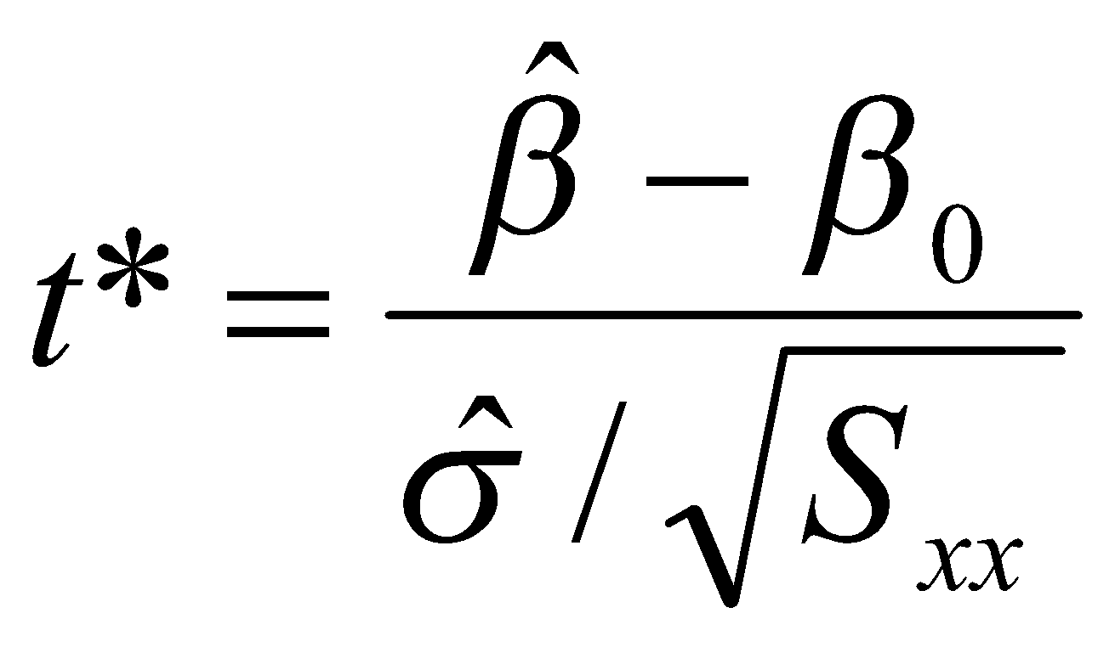
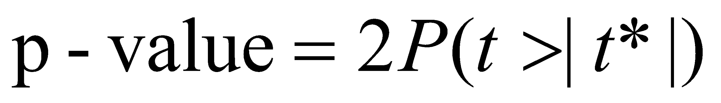
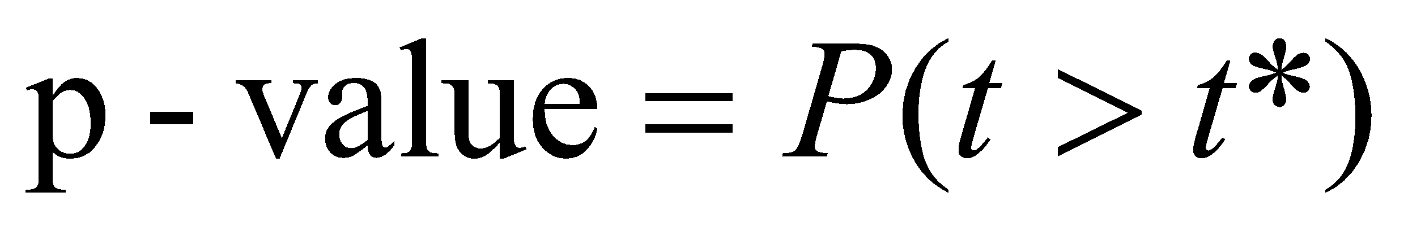
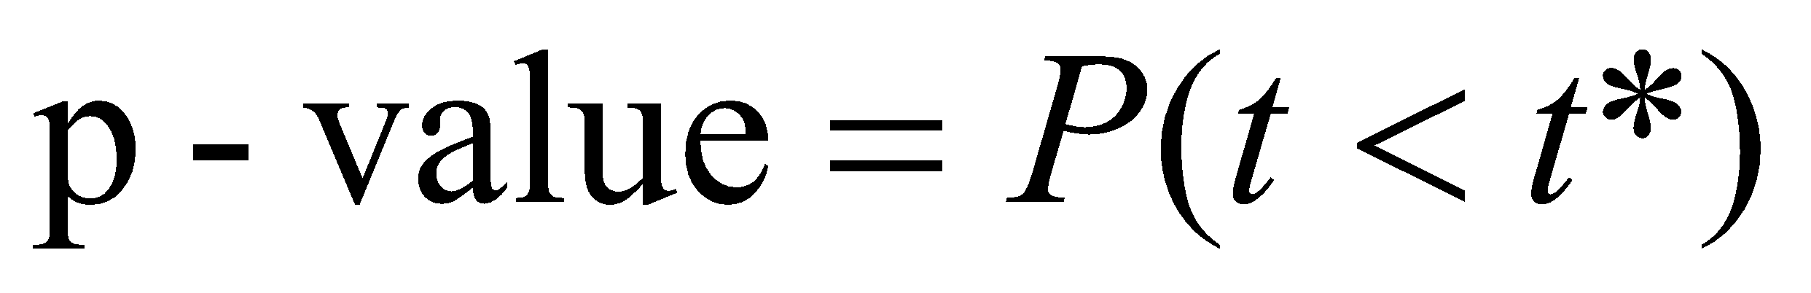
Hypothesis Tests Concerning β
Step 3: Find p-value. Compute
sample statistic
H_{a}: β ≠ β₀ (two-sided test)
H_{a}: β > β₀ (one-sided test)
H_{a}: β < β₀ (one-sided test)
P(t>|t*|), P(t>t*) and P(t<t*) can be found from the t table

Slide 46
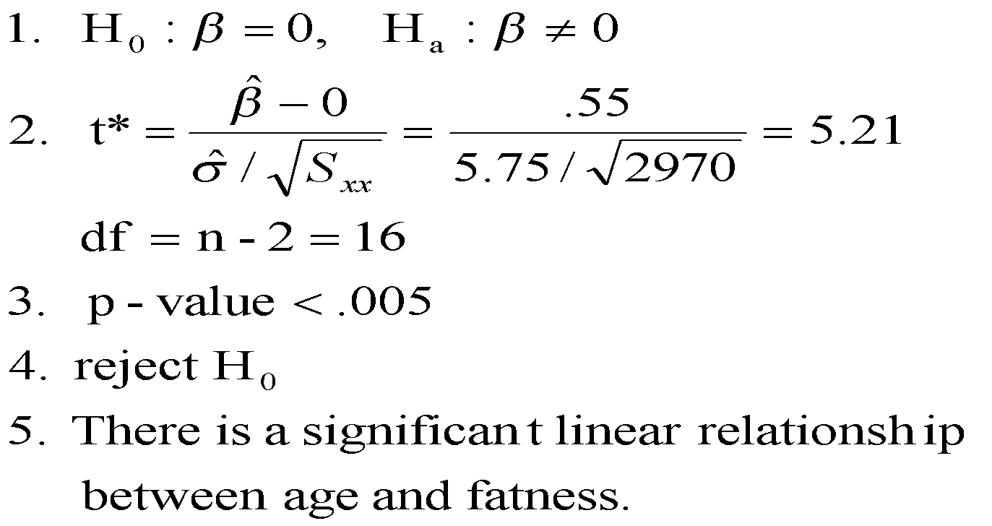
Example: Age and Fatness

Slide 47
Interpreting a Significant Regression
Even if you do not reject the null hypothesis that the slope of the line equals 0, it does not necessarily mean that y and x are unrelated.
It may happen that y and x are perfectly related in a nonlinear way.
Causality—Do not conclude that x causes y. There may be an unknown variable at work!

Slide 48
Checking the Regression Assumptions
Remember that the results of a regression analysis are only valid when the necessary assumptions have been satisfied.
The relationship between x and y is linear, given by y = α + βx + ε.
The random error terms ε are independent and, for any value of x, have a normal distribution with mean 0 and variance σ ².

Slide 49
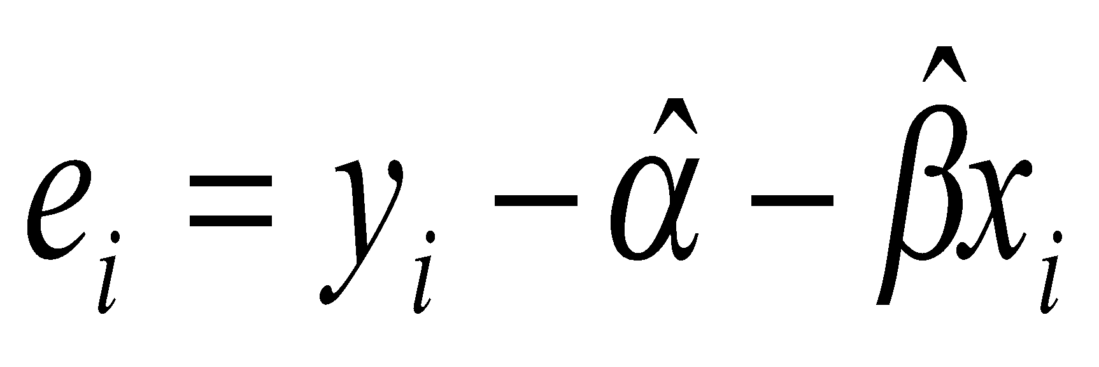
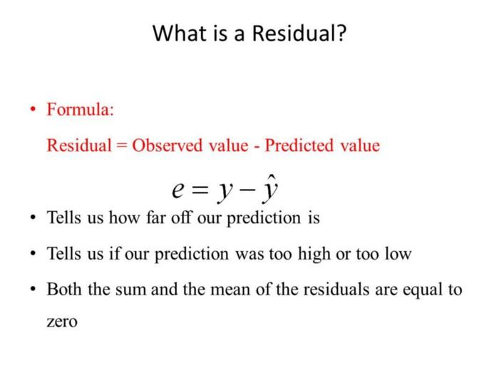
Residuals
The residual corresponding to (x_{i},y_{i}) is
The residual is the “leftover” variation in each data point after the variation explained by the regression model has been removed.
Residuals reflect random errors, thus we can use them to check violations in the assumptions about random errors.
fitted line
e₁
e₂
0
x = x₁
x = x₂
0

Slide 50
Diagnostic Tools – Residual Plots
We can check the normality and equal variance assumptions using
Normal probability plot of residuals
2. Plot of residuals versus fit or residuals versus variables

Slide 51
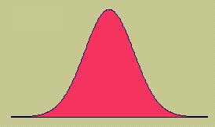
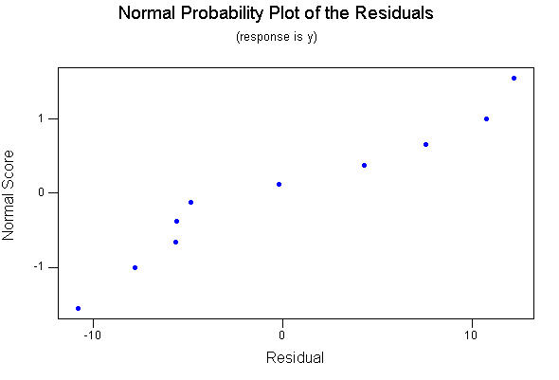
Normal Probability Plot
If the normality assumption is valid, the plot should resemble a straight line, sloping upward to the right.
If not, you will often see the pattern fail in the tails of the graph.

Slide 52
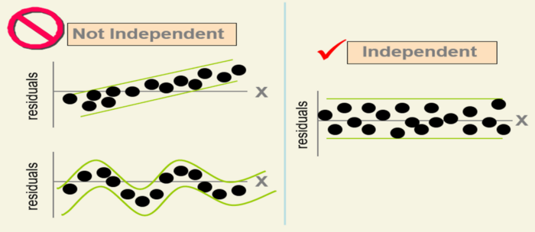
Residuals versus Fits

Slide 53
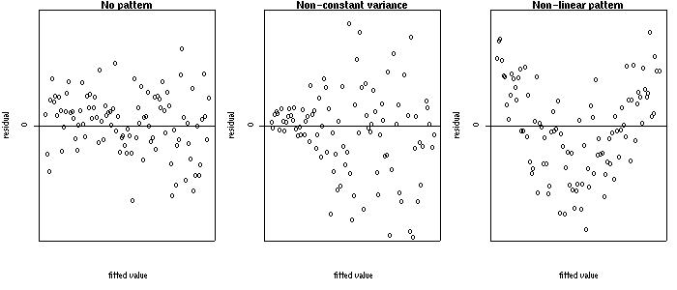
Residuals versus Fits
If the equal variance assumption is valid, the plot should appear as a random scatter around the zero center line.
If not, you will see a pattern in the residuals.

Slide 54
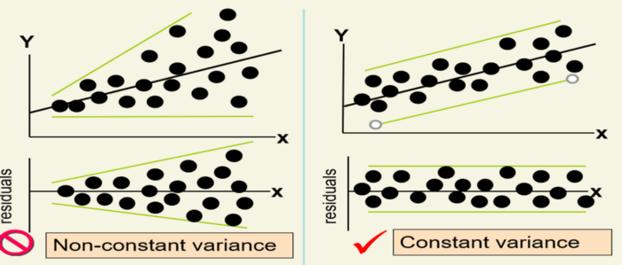
Residuals versus Fits

Slide 55
Estimation and Prediction
Once we have
determined that the regression line is useful
used the diagnostic plots to check for violation of the regression assumptions.
We are ready to use the regression line to
Estimate the average value of y for a given value of x
Predict a particular value of y for a given value of x.

Slide 56
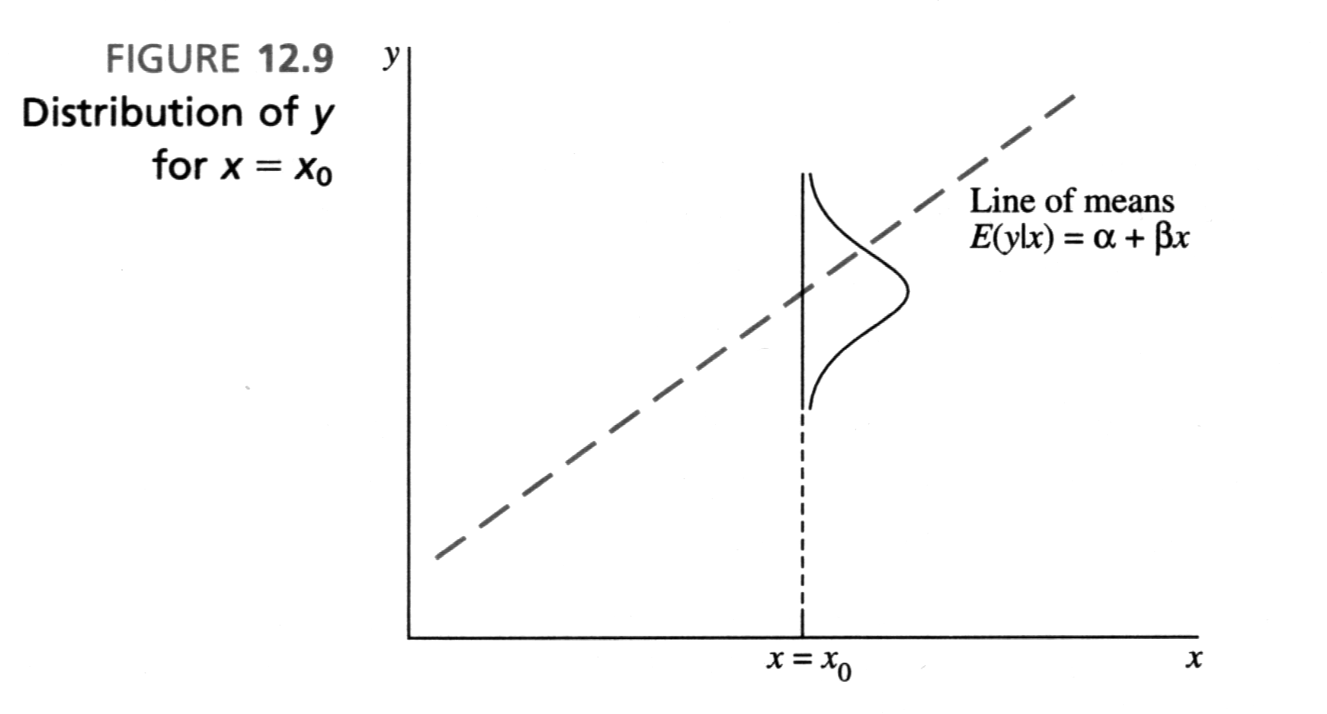
Estimation and Prediction
Predicting a particular value of y when x = x₀
Estimating the average value of y when x = x₀

Slide 57
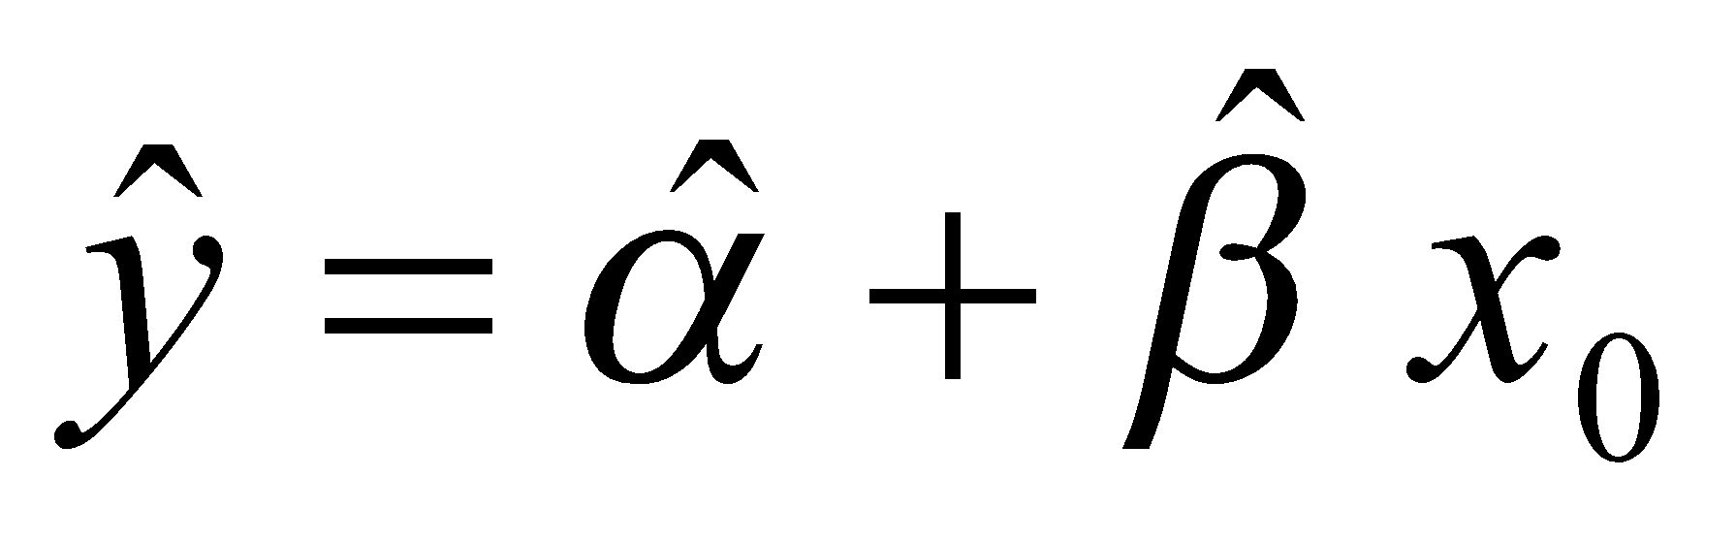
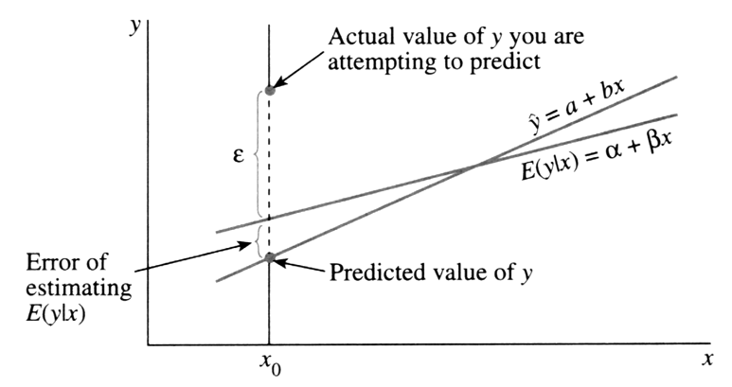
Estimation and Prediction
The best estimate of the average value of y and prediction of y for a given value x = x₀ is
The prediction of y is more difficult, requiring a wider range of values in the prediction interval.

Slide 58
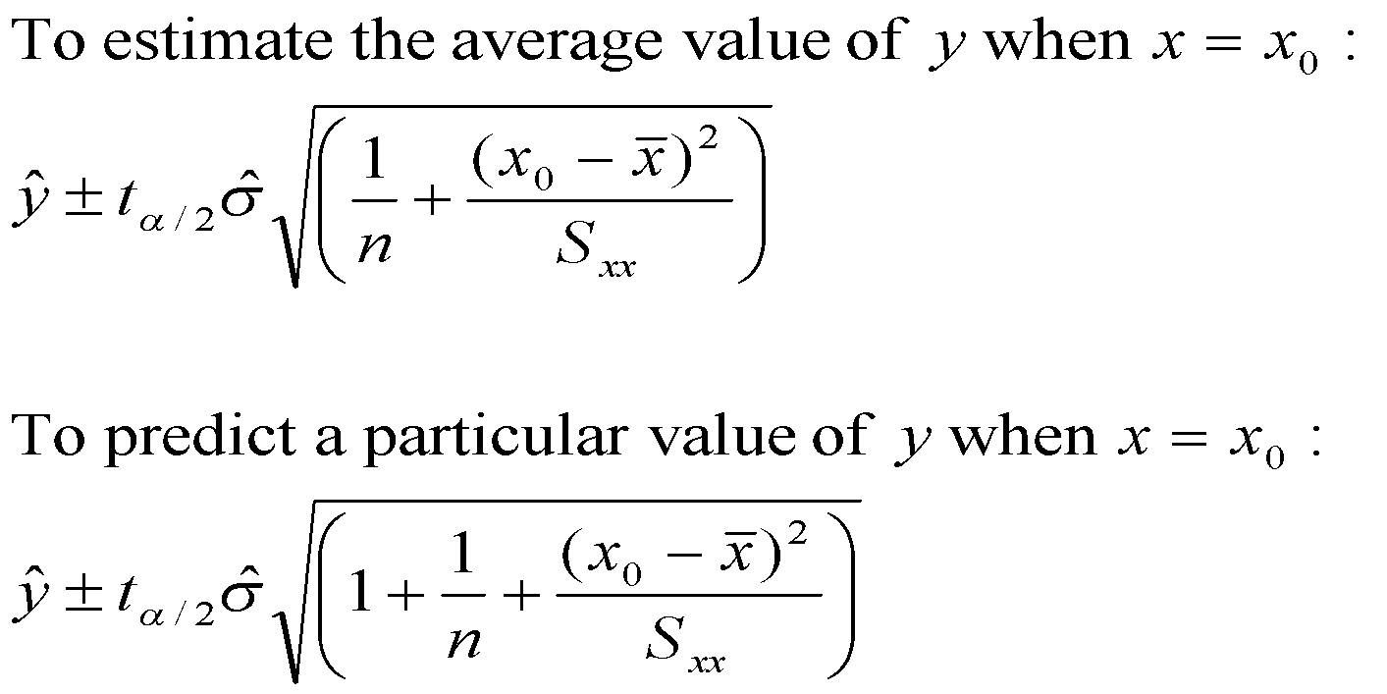
Estimation and Prediction

Slide 59
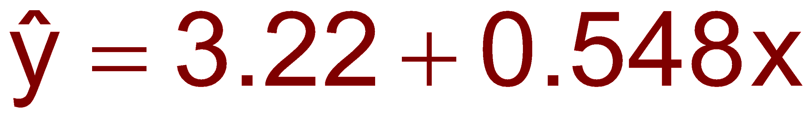
Example: Age and Fatness
The fitted line is
If x₀=45 is put into the equation for x, we have both an estimated average %Fat for 45 year old humans and a predicted %Fat for a 45 year old human
3.22+0.548(45)=27.9%
The two interpretations are quite different.

Slide 60

Example: Age and Fatness

Slide 61

Example 2:
A car dealer wants to find the relationship between the odometer reading and the selling price of used cars.
A random sample of 100 cars is selected, and the data recorded.
Find the regression line.
Independent variable x
Dependent variable y

Slide 62




Example Contd
Solution
Solving by hand: Calculate a number of statistics
where n = 100.

Slide 63


Interpreting the Linear Regression -Equation
17067
0
No data
The intercept is b₀ = $17067.
This is the slope of the line.
For each additional mile on the odometer,
the price decreases by an average of $0.0623
Do not interpret the intercept as the
“Price of cars that have not been driven”

Slide 64
Assessing the Model
The least squares method will produces a regression line whether or not there is a linear relationship between x and y.
Consequently, it is important to assess how well the linear model fits the data.
Several methods are used to assess the model. All are based on the sum of squares for errors, SSE.

Slide 65


Sum of Squares for Errors
This is the sum of differences between the points and the regression line.
It can serve as a measure of how well the line fits the data. SSE is defined by
A shortcut formula

Slide 66

Standard Error of Estimate
The mean error is equal to zero.
If σ_{ε} is small the errors tend to be close to zero (close to the mean error). Then, the model fits the data well.
Therefore, we can, use σ_{ε} as a measure of the suitability of using a linear model.
An estimator of σ_{ε} is given by s_{ε}

Slide 67


Standard Error of Estimate - Example
Example:
Calculate the standard error of estimate for the previous example and describe what it tells you about the model fit.
Solution
It is hard to assess the model based
on s_{ε} even when compared with the
mean value of y.

Slide 68
Testing the slope
When no linear relationship exists between two variables, the regression line should be horizontal.
❑
❑
❑
❑
❑
❑
❑
❑
❑
❑
❑
❑
❑
❑
❑
❑
❑
❑
❑
❑
❑
❑
❑
❑
❑
❑
❑
❑
❑
❑
❑
❑
❑
❑
❑
❑
❑
❑
❑
❑
❑
❑
❑
❑
❑
❑
❑
❑
❑
❑
❑
❑
❑
❑
❑
❑
❑
❑
❑
❑
❑
❑
❑
❑
❑
❑
❑
❑
❑
❑
❑
❑
❑
❑
❑
❑
❑
❑
❑
❑
❑
❑
❑
❑
❑
❑
❑
❑
❑
❑
❑
❑
❑
❑
❑
❑
❑
❑
❑
❑
❑
❑
❑
❑
❑
❑
❑
❑
❑
❑
❑
❑
Linear relationship.
Linear relationship.
Linear relationship.
Linear relationship.
No linear relationship.
Different inputs (x) yield
the same output (y).
Different inputs (x) yield
different outputs (y).
The slope is not equal to zero
The slope is equal to zero

Slide 69


Testing the Slope
We can draw inference about β₁ from b₁ by testing
H₀: β₁ = 0
H₁: β₁ = 0 (or < 0,or > 0)
The test statistic is
If the error variable is normally distributed, the statistic is Student t distribution with d.f. = n-2.
where
The standard error of b₁.

Slide 70
Example
Test to determine whether there is enough evidence to infer that there is a linear relationship between the car auction price and the odometer reading for all three-year-old Tauruses in the previous example . Use α = 5%.
Solving by hand
To compute “t” we need the values of b₁ and s_{b1}.
The rejection region is t > t_{.025} or t < -t_{.025} with ν = n-2 = 98. Approximately, t_{.025} = 1.984

Slide 71

Testing the Slope- Example
Using the computer
There is overwhelming evidence to infer
that the odometer reading affects the
auction selling price.

Slide 72




Coefficient of determination
To measure the strength of the linear relationship
y₂
Two data points (x₁,y₁) and (x₂,y₂)
of a certain sample are shown.
y
Variation in y = SSR + SSE
y₁
x₁
x₂
Variation explained by the
regression line
Total variation in y =
+ Unexplained variation (error)
Note that the coefficient of determination is r²

Slide 73

Coefficient of determination
R² measures the proportion of the variation in y that is explained by the variation in x.
R² takes on any value between zero and one.
R² = 1: Perfect match between the line and the data points.
R² = 0: There are no linear relationship between x and y.

Slide 74


Coefficient of determination,Example
Example
Find the coefficient of determination for the used car price –odometer example.what does this statistic tell you about the model?
Solution
Solving by hand;

Slide 75

Coefficient of determination
Using the computer From the regression output we have
65% of the variation in the auction
selling price is explained by the
variation in odometer reading. The
rest (35%) remains unexplained by
this model.

Slide 76
Using the Regression Equation
Before using the regression model, we need to assess how well it fits the data.
If we are satisfied with how well the model fits the data, we can use it to predict the values of y.
To make a prediction we use
Point prediction, and
Interval prediction

Slide 77
Point Prediction
Example
Predict the selling price of a three-year-old Taurus with 40,000 miles on the odometer.
A point prediction
It is predicted that a 40,000 miles car would sell for $14,575.
How close is this prediction to the real price?

Slide 78


Interval Estimates
Two intervals can be used to discover how closely the predicted value will match the true value of y.
Prediction interval – predicts y for a given value of x,
Confidence interval – estimates the average y for a given x.
The prediction interval
The confidence interval

Slide 79
Interval Estimates, Example
Example - continued
Provide an interval estimate for the bidding price on a Ford Taurus with 40,000 miles on the odometer.
Two types of predictions are required:
A prediction for a specific car
An estimate for the average price per car

Slide 80

Interval Estimates, Example
Solution
A prediction interval provides the price estimate for a single car:
t_{.025,98}
_{Approximately}

Slide 81


Interval Estimates, Example
Solution – continued
A confidence interval provides the estimate of the mean price per car for a Ford Taurus with 40,000 miles reading on the odometer.
The confidence interval (95%) =

Slide 82



Slide 83



Slide 84



Slide 85




Slide 86



Slide 87
Multiple Linear Regession
Introduction to Multiple Linear Regression
: Assessing the Model,
Cross-Validation, Model Selection and Stepwise Regression,

Slide 88

The Multiple Regression Model
Idea: Examine the linear relationship between
1 dependent (Y) & 2 or more independent variables (X_{i})
Multiple Regression Model with k Independent Variables:
Y-intercept
Population slopes
Random Error

Slide 89

Multiple Regression Equation
The coefficients of the multiple regression model are estimated using sample data
Multiple regression equation with k independent variables:
Estimated
(or predicted)
value of y
Estimated
intercept
Estimated slope coefficients
In this chapter we will always use a computer to obtain the regression slope coefficients and other regression summary measures.

Slide 90

Multiple Regression Equation
(continued)
Two variable model
y
Slope for variable x₁
x₂
Slope for variable x₂
x₁

Slide 91
Standard Multiple Regression Assumptions
The values x_{i} and the error terms ε_{i} are independent
The error terms are random variables with mean 0 and a constant variance, σ².
(The constant variance property is called
homoscedasticity)

Slide 92


Standard Multiple Regression Assumptions
The random error terms, ε_{i} , are not correlated with one another, so that
It is not possible to find a set of numbers, c₀, c₁, . . . , c_{k}, such that
(This is the property of no linear relation for the X_{j}’s)

Slide 93

Example: 2 Independent Variables
A distributor of frozen desert pies wants to evaluate factors thought to influence demand
Dependent variable: Pie sales (units per week)
Independent variables: Price (in $)
Advertising ($100’s)
Data are collected for 15 weeks

Slide 94

Pie Sales Example
Week | Pie Sales | Price ($) | Advertising ($100s)
1 | 350 | 5.50 | 3.3
2 | 460 | 7.50 | 3.3
3 | 350 | 8.00 | 3.0
4 | 430 | 8.00 | 4.5
5 | 350 | 6.80 | 3.0
6 | 380 | 7.50 | 4.0
7 | 430 | 4.50 | 3.0
8 | 470 | 6.40 | 3.7
9 | 450 | 7.00 | 3.5
10 | 490 | 5.00 | 4.0
11 | 340 | 7.20 | 3.5
12 | 300 | 7.90 | 3.2
13 | 440 | 5.90 | 4.0
14 | 450 | 5.00 | 3.5
15 | 300 | 7.00 | 2.7
Multiple regression equation:
Sales = b₀ + b₁ (Price)
+ b₂ (Advertising)

Slide 95
Estimating a Multiple Linear Regression Equation
Excel will be used to generate the coefficients and measures of goodness of fit for multiple regression
Excel:
Tools / Data Analysis... / Regression
PHStat:
PHStat / Regression / Multiple Regression…

Slide 96
Multiple Regression Output
Regression Statistics
Multiple R | 0.72213
R Square | 0.52148
Adjusted R Square | 0.44172
Standard Error | 47.46341
Observations | 15
ANOVA | df | SS | MS | F | Significance F
Regression | 2 | 29460.027 | 14730.013 | 6.53861 | 0.01201
Residual | 12 | 27033.306 | 2252.776
Total | 14 | 56493.333
 | Coefficients | Standard Error | t Stat | P-value | Lower 95% | Upper 95%
Intercept | 306.52619 | 114.25389 | 2.68285 | 0.01993 | 57.58835 | 555.46404
Price | -24.97509 | 10.83213 | -2.30565 | 0.03979 | -48.57626 | -1.37392
Advertising | 74.13096 | 25.96732 | 2.85478 | 0.01449 | 17.55303 | 130.70888

Slide 97
The Multiple Regression Equation
where
Sales is in number of pies per week
Price is in $
Advertising is in $100’s.
b₁ = -24.975: sales will decrease, on average, by 24.975 pies per week for each $1 increase in selling price, net of the effects of changes due to advertising
b₂ = 74.131: sales will increase, on average, by 74.131 pies per week for each $100 increase in advertising, net of the effects of changes due to price

Slide 98

Coefficient of Determination, R²
Reports the proportion of total variation in y explained by all x variables taken together
This is the ratio of the explained variability to total sample variability

Slide 99

Coefficient of Determination, R²
(continued)
Regression Statistics
Multiple R | 0.72213
R Square | 0.52148
Adjusted R Square | 0.44172
Standard Error | 47.46341
Observations | 15
ANOVA | df | SS | MS | F | Significance F
Regression | 2 | 29460.027 | 14730.013 | 6.53861 | 0.01201
Residual | 12 | 27033.306 | 2252.776
Total | 14 | 56493.333
 | Coefficients | Standard Error | t Stat | P-value | Lower 95% | Upper 95%
Intercept | 306.52619 | 114.25389 | 2.68285 | 0.01993 | 57.58835 | 555.46404
Price | -24.97509 | 10.83213 | -2.30565 | 0.03979 | -48.57626 | -1.37392
Advertising | 74.13096 | 25.96732 | 2.85478 | 0.01449 | 17.55303 | 130.70888
52.1% of the variation in pie sales is explained by the variation in price and advertising

Slide 100


Estimation of Error Variance
Consider the population regression model
The unbiased estimate of the variance of the errors is
where
The square root of the variance, s_{e} , is called the standard error of the estimate

Slide 101

Standard Error, s_{e}
Regression Statistics
Multiple R | 0.72213
R Square | 0.52148
Adjusted R Square | 0.44172
Standard Error | 47.46341
Observations | 15
ANOVA | df | SS | MS | F | Significance F
Regression | 2 | 29460.027 | 14730.013 | 6.53861 | 0.01201
Residual | 12 | 27033.306 | 2252.776
Total | 14 | 56493.333
 | Coefficients | Standard Error | t Stat | P-value | Lower 95% | Upper 95%
Intercept | 306.52619 | 114.25389 | 2.68285 | 0.01993 | 57.58835 | 555.46404
Price | -24.97509 | 10.83213 | -2.30565 | 0.03979 | -48.57626 | -1.37392
Advertising | 74.13096 | 25.96732 | 2.85478 | 0.01449 | 17.55303 | 130.70888
The magnitude of this value can be compared to the average y value

Slide 102
Adjusted Coefficient of Determination
R² never decreases when a new X variable is added to the model, even if the new variable is not an important predictor variable
This can be a disadvantage when comparing models
What is the net effect of adding a new variable?
We lose a degree of freedom when a new X variable is added
Did the new X variable add enough explanatory power to offset the loss of one degree of freedom?

Slide 103

Adjusted Coefficient of Determination
(continued)
Used to correct for the fact that adding non-relevant independent variables will still reduce the error sum of squares
Adjusted R² provides a better comparison between multiple regression models with different numbers of independent variables
Penalize excessive use of unimportant independent variables
Smaller than R²
(where n = sample size, K = number of independent variables)

Slide 104

Regression Statistics
Multiple R | 0.72213
R Square | 0.52148
Adjusted R Square | 0.44172
Standard Error | 47.46341
Observations | 15
ANOVA | df | SS | MS | F | Significance F
Regression | 2 | 29460.027 | 14730.013 | 6.53861 | 0.01201
Residual | 12 | 27033.306 | 2252.776
Total | 14 | 56493.333
 | Coefficients | Standard Error | t Stat | P-value | Lower 95% | Upper 95%
Intercept | 306.52619 | 114.25389 | 2.68285 | 0.01993 | 57.58835 | 555.46404
Price | -24.97509 | 10.83213 | -2.30565 | 0.03979 | -48.57626 | -1.37392
Advertising | 74.13096 | 25.96732 | 2.85478 | 0.01449 | 17.55303 | 130.70888
44.2% of the variation in pie sales is explained by the variation in price and advertising, taking into account the sample size and number of independent variables

Slide 105

Coefficient of Multiple Correlation
The coefficient of multiple correlation is the correlation between the predicted value and the observed value of the dependent variable
Is the square root of the multiple coefficient of determination
Used as another measure of the strength of the linear relationship between the dependent variable and the independent variables
Comparable to the correlation between Y and X in simple regression

Slide 106
Evaluating Individual Regression Coefficients
Use t-tests for individual coefficients
Shows if a specific independent variable is conditionally important
Hypotheses:
H₀: β_{j} = 0 (no linear relationship)
H₁: β_{j} ≠ 0 (linear relationship does exist
between x_{j} and y)

Slide 107

Evaluating Individual Regression Coefficients
(continued)
H₀: β_{j} = 0 (no linear relationship)
H₁: β_{j} ≠ 0 (linear relationship does exist between x_{i} and y)
Test Statistic:
(df = n – k – 1)

Slide 108
Evaluating Individual Regression Coefficients
(continued)
Regression Statistics
Multiple R | 0.72213
R Square | 0.52148
Adjusted R Square | 0.44172
Standard Error | 47.46341
Observations | 15
ANOVA | df | SS | MS | F | Significance F
Regression | 2 | 29460.027 | 14730.013 | 6.53861 | 0.01201
Residual | 12 | 27033.306 | 2252.776
Total | 14 | 56493.333
 | Coefficients | Standard Error | t Stat | P-value | Lower 95% | Upper 95%
Intercept | 306.52619 | 114.25389 | 2.68285 | 0.01993 | 57.58835 | 555.46404
Price | -24.97509 | 10.83213 | -2.30565 | 0.03979 | -48.57626 | -1.37392
Advertising | 74.13096 | 25.96732 | 2.85478 | 0.01449 | 17.55303 | 130.70888
t-value for Price is t = -2.306, with p-value .0398
t-value for Advertising is t = 2.855, with p-value .0145

Slide 109
Example: Evaluating Individual Regression Coefficients
From Excel output:
H₀: β_{j} = 0
H₁: β_{j} ≠ 0
 | Coefficients | Standard Error | t Stat | P-value
Price | -24.97509 | 10.83213 | -2.30565 | 0.03979
Advertising | 74.13096 | 25.96732 | 2.85478 | 0.01449
d.f. = 15-2-1 = 12
= .05
t_{12, .025} = 2.1788
The test statistic for each variable falls in the rejection region (p-values < .05)
Decision:
Conclusion:
α/2=.025
α/2=.025
Reject H₀ for each variable
There is evidence that both Price and Advertising affect pie sales at α = .05
Reject H₀
Do not reject H₀
Reject H₀
-t_{α/2}
t_{α/2}
0
-2.1788
2.1788

Slide 110

Confidence Interval Estimate for the Slope
Confidence interval limits for the population slope β_{j}
where t has
(n – K – 1) d.f.
 | Coefficients | Standard Error
Intercept | 306.52619 | 114.25389
Price | -24.97509 | 10.83213
Advertising | 74.13096 | 25.96732
Here, t has
(15 – 2 – 1) = 12 d.f.
Example: Form a 95% confidence interval for the effect of changes in price (x₁) on pie sales:
-24.975 ± (2.1788)(10.832)
So the interval is -48.576 < β₁ < -1.374

Slide 111
Confidence Interval Estimate for the Slope
(continued)
Confidence interval for the population slope β_{i}
 | Coefficients | Standard Error | … | Lower 95% | Upper 95%
Intercept | 306.52619 | 114.25389 | … | 57.58835 | 555.46404
Price | -24.97509 | 10.83213 | … | -48.57626 | -1.37392
Advertising | 74.13096 | 25.96732 | … | 17.55303 | 130.70888
Example: Excel output also reports these interval endpoints:
Weekly sales are estimated to be reduced by between 1.37 to 48.58 pies for each increase of $1 in the selling price

Slide 112
Test on All Coefficients
F-Test for Overall Significance of the Model
Shows if there is a linear relationship between all of the X variables considered together and Y
Use F test statistic
Hypotheses:
β_{i} ≠ 0 H₀: β₁ = β₂ = … = β_{k} = 0 (no linear relationship)
H₁: at least one (at least one independent variable affects Y)

Slide 113


F-Test for Overall Significance
Test statistic:
where F has k (numerator) and
(n – K – 1) (denominator) degrees of freedom
The decision rule is

Slide 114

F-Test for Overall Significance
(continued)
Regression Statistics
Multiple R | 0.72213
R Square | 0.52148
Adjusted R Square | 0.44172
Standard Error | 47.46341
Observations | 15
ANOVA | df | SS | MS | F | Significance F
Regression | 2 | 29460.027 | 14730.013 | 6.53861 | 0.01201
Residual | 12 | 27033.306 | 2252.776
Total | 14 | 56493.333
 | Coefficients | Standard Error | t Stat | P-value | Lower 95% | Upper 95%
Intercept | 306.52619 | 114.25389 | 2.68285 | 0.01993 | 57.58835 | 555.46404
Price | -24.97509 | 10.83213 | -2.30565 | 0.03979 | -48.57626 | -1.37392
Advertising | 74.13096 | 25.96732 | 2.85478 | 0.01449 | 17.55303 | 130.70888
With 2 and 12 degrees of freedom
P-value for the F-Test

Slide 115

F-Test for Overall Significance
(continued)
H₀: β₁ = β₂ = 0
H₁: β₁ and β₂ not both zero
α = .05
df₁= 2 df₂ = 12
Test Statistic:
Decision:
Conclusion:
Critical Value:
F_{α} = 3.885
Since F test statistic is in the rejection region (p-value < .05), reject H₀
α = .05
0
F
There is evidence that at least one independent variable affects Y
Do not
reject H₀
Reject H₀
F_{.05} = 3.885

Slide 116

Tests on a Subset of Regression Coefficients
Consider a multiple regression model involving variables x_{j} and z_{j} , and the null hypothesis that the z variable coefficients are all zero:

Slide 117

Tests on a Subset of Regression Coefficients
(continued)
Goal: compare the error sum of squares for the complete model with the error sum of squares for the restricted model
First run a regression for the complete model and obtain SSE
Next run a restricted regression that excludes the z variables (the number of variables excluded is r) and obtain the restricted error sum of squares SSE(r)
Compute the F statistic and apply the decision rule for a significance level α

Slide 118
Prediction
Given a population regression model
then given a new observation of a data point
(x_{1,n+1}, x _{2,n+1}, . . . , x _{K,n+1})
the best linear unbiased forecast of y_{n+1} is
It is risky to forecast for new X values outside the range of the data used to estimate the model coefficients, because we do not have data to support that the linear model extends beyond the observed range.
^

Slide 119

Using The Equation to Make Predictions
Predict sales for a week in which the selling price is $5.50 and advertising is $350:
Note that Advertising is in $100’s, so $350 means that X₂ = 3.5
Predicted sales is 428.62 pies

Slide 120

Predictions in PHStat
(continued)
Input values
Predicted y value
<
Confidence interval for the mean y value, given these x’s
<
Prediction interval for an individual y value, given these x’s
<

Slide 121
Residuals in Multiple Regression
Two variable model
<
y
Sample observation
Residual = e_{i} = (y_{i} – y_{i})
y_{i}
<
y_{i}
x_{2i}
x₂
x_{1i}
x₁

Slide 122

Model Selection Criteria – All Possible Regressions

Slide 123
Regression Model Building
Setting: Possibly a large set of predictor variables (including interactions).
Goal: Fit a parsimonious model that explains variation in Y with a small set of predictors
Automated Procedures and all possible regressions:
Backward Elimination (Top down approach)
Forward Selection (Bottom up approach)
Stepwise Regression (Combines Forward/Backward)

Slide 124
Backward Elimination Traditional Approach
Select a significance level to stay in the model (e.g. SLS=0.20, generally .05 is too low, causing too many variables to be removed)
Fit the full model with all possible predictors
Consider the predictor with lowest t-statistic (highest P-value).
If P > SLS, remove the predictor and fit model without this variable (must re-fit model here because partial regression coefficients change)
If P ≤ SLS, stop and keep current model
Continue until all predictors have P-values below SLS
Note: R uses model based criteria: AIC, SBC instead

Slide 125
Forward Selection – Traditional Approach
Choose a significance level to enter the model (e.g. SLE=0.20, generally .05 is too low, causing too few variables to be entered)
Fit all simple regression models.
Consider the predictor with the highest t-statistic (lowest P-value)
If P ≤ SLE, keep this variable and fit all two variable models that include this predictor
If P > SLE, stop and keep previous model
Continue until no new predictors have P ≤ SLE
Note: R uses model based criteria: AIC, SBC instead

Slide 126
Stepwise Regression – Traditional Approach
Select SLS and SLE (SLE<SLS)
Starts like Forward Selection (Bottom up process)
New variables must have P ≤ SLE to enter
Re-tests all “old variables” that have already been entered, must have P ≤ SLS to stay in model
Continues until no new variables can be entered and no old variables need to be removed
Note: R uses model based criteria: AIC, SBC instead

Slide 127


Model Validation
When we have a lot of data, we would like to see how well a model fit on one set of data (training sample) compares to one fit on a new set of data (validation sample), and how the training model fits the new data.
Want data sets to be similar wrt levels of the predictors
Training set should have at least 6-10 times as many observations than potential predictors
Models should give similar model fits based on SSE_{p}, PRESS_{p}, C_{p}, and MSE_{p} and regression coefficients
Mean Square Prediction Error when training model is applied to validation sample:

Slide 128


Slide 129


Slide 130


